Slide 1
Careers in Environmental Science & Engineering
Notes:
Today’s PPT is about careers in environmental science and engineering. Does anyone have any ideas about what kind of job you can get in these fields?

Slide 2
What kinds of jobs?
Freshwater Scientist
Forester
Environmental Engineer
Environmental Resource Manager
Environmental Scientist
Hydrologist
Urban Planner
Agricultural Engineer
Ecologist
Atmospheric Scientist
Restoration Technician
Conservation Scientist
Renewable Energy Engineer
Chemical Oceanographer
GIS Analyst
Park Ranger
Fisheries Conservationist
Environmental Consultant
Social Scientist
Notes:
The point: there are a lot! You could be doing 1 of a thousand jobs if you decide to work in environmental science.

Slide 3
Where do they work?
Everywhere!
Notes:
Ask them where they think environmental scientists work.

Slide 4
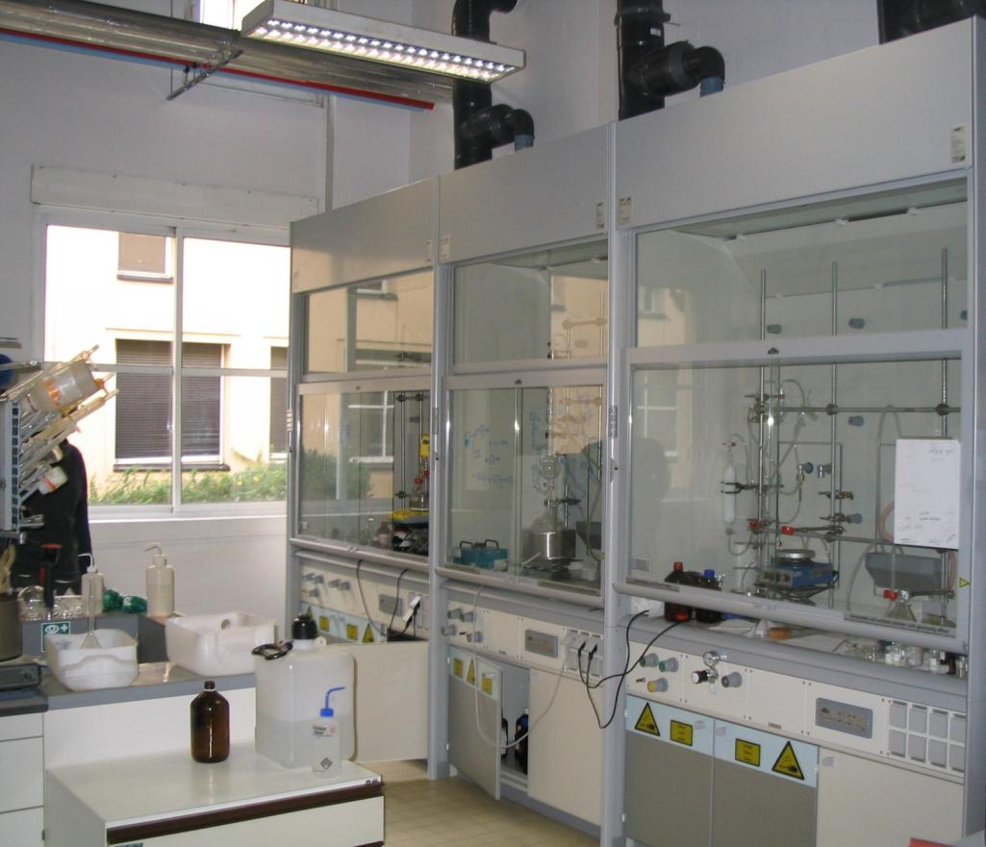
In laboratories

Slide 5
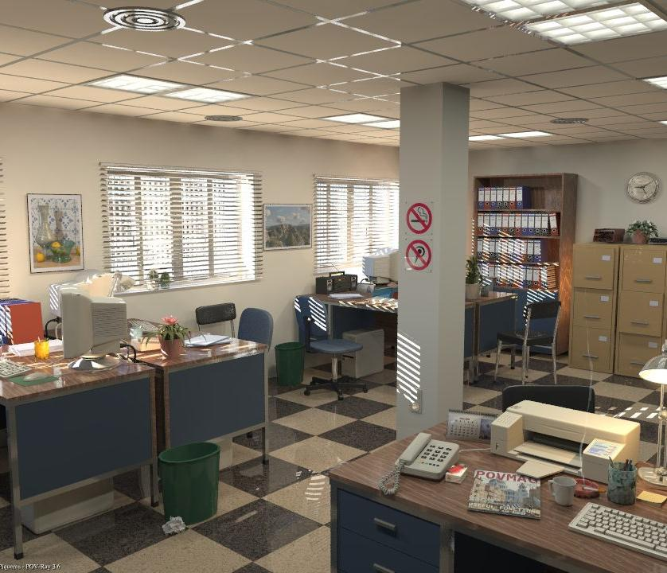
At a desk

Slide 6
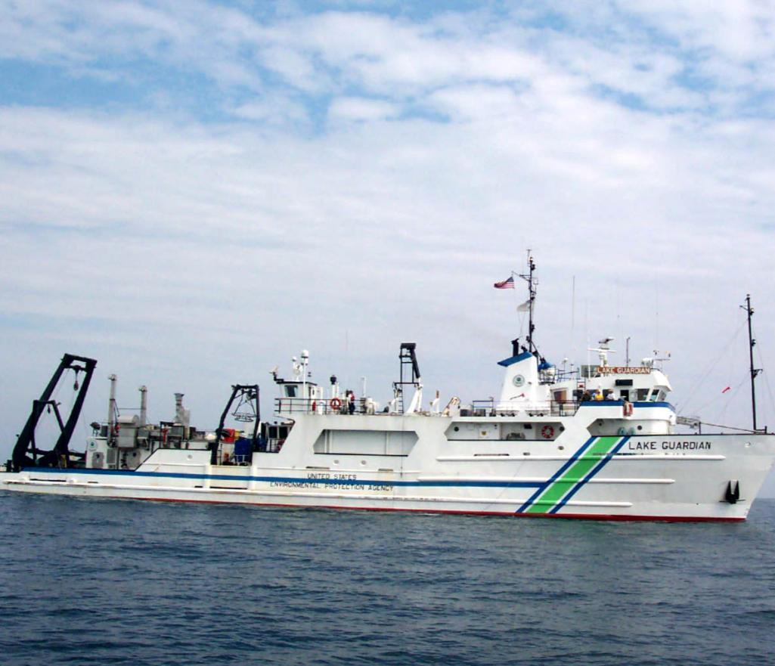
On ships

Slide 7
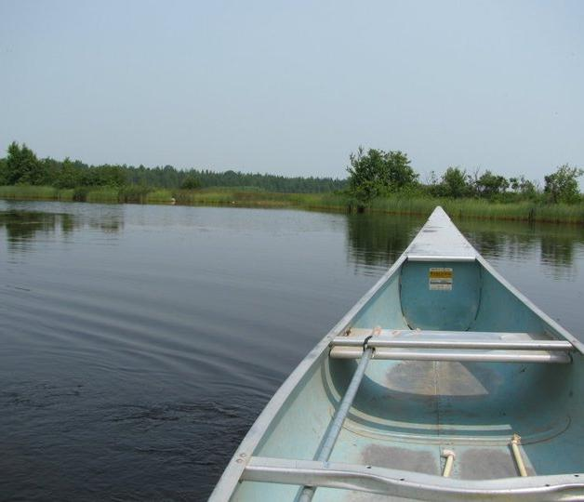
In the field

Slide 8
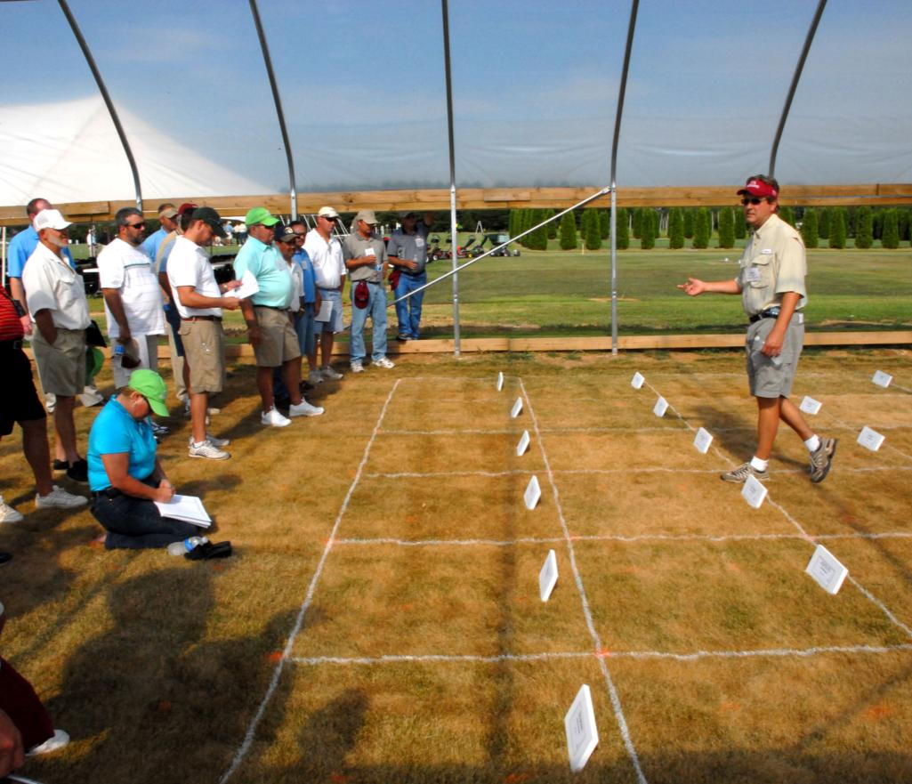
On farms

Slide 9
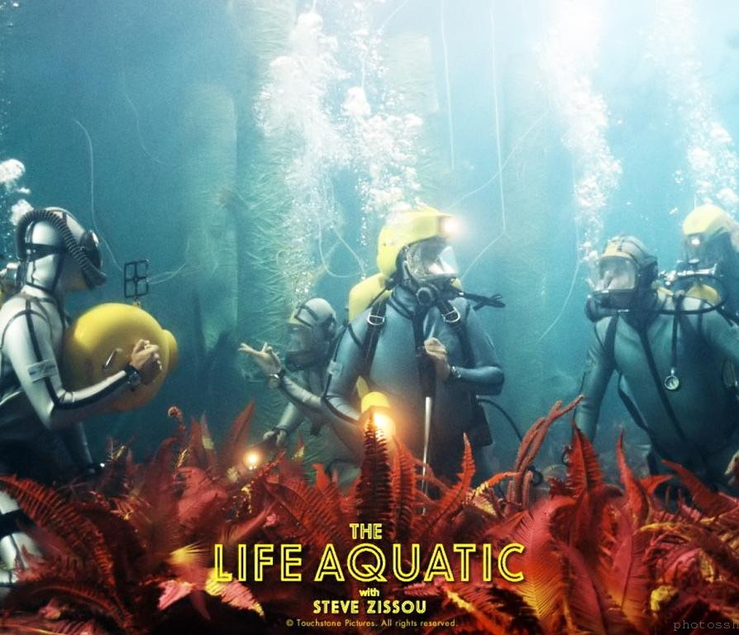
Underwater

Slide 10
What interests environmental scientists and engineers?
Animals
Plants
Climate change
Pollution
Creative problem solving
Policy
Research
Human health
Human impacts on the environment
Maps
Computers
Improving the environment
People
Complex math
Communication
Notes:
These are the types of things people are interested in when they go into environmental science and engineering.

Slide 11
What classes should I take in high school?
Math
Science/Technology
Algebra
Statistics
Geometry
Trigonometry
Calculus I
AP/Honors
Lab sciences
Biology
Physics
Chemistry
Environmental science
Computer sciences
AP/Honors
Notes:
Here are a couple of lists of classes you should take in high school to prepare yourself for a major in environmental science and engineering.

Slide 12
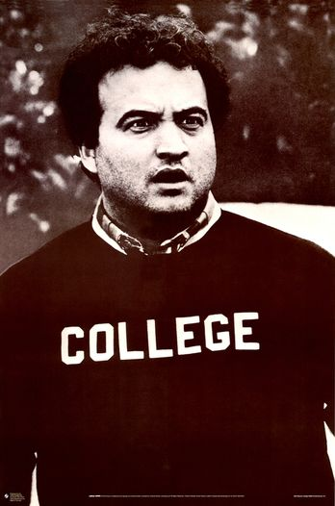
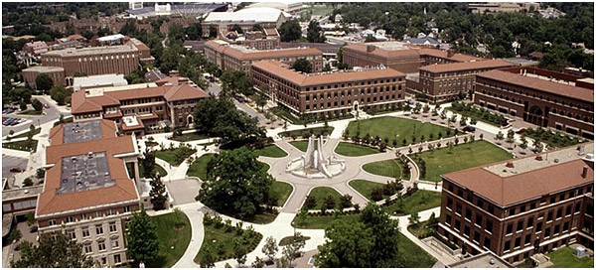
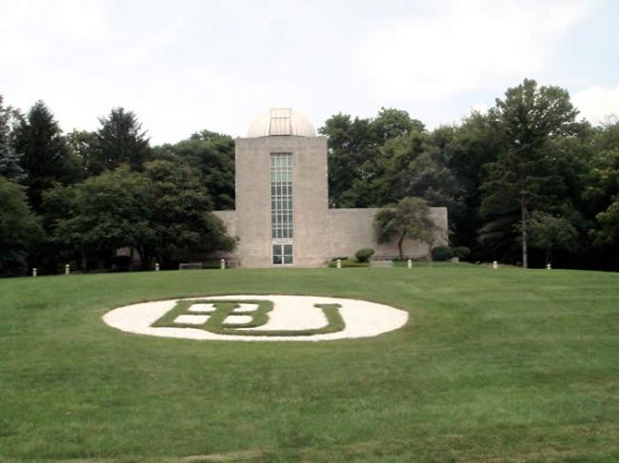
College
Notes:
Does anyone here have plans to go to college? Anyone have any idea of what majors you can major in to pursue a career in environmental science or engineering?

Slide 13
What should I major in?
Undergraduate/ Bachelor’s
Graduate/ Master’s and Ph.D
Biology
Chemistry
Ecology
Geology
Environmental science
(There are more specific majors)
Environmental engineering
Science and technology studies
Any science
Environmental policy
Environmental science
Natural resource management
Human dimensions
Urban planning
Landscape architecture
Public/environmental affairs
MPA/MPP
Notes:
This is not an exhaustive list, but here are some examples of college majors.

Slide 14
Internships: Summers matter!
High school and college
Paid and unpaid
Research experience for undergraduates
Government
Non-profits
Universities
Private companies
Notes:
Internships are very important. They give you a leg up in experience and make you a more attractive candidate for a job.

Slide 15
Tools
Strong Interest Inventory
Strengths Quest
Myers-Briggs
Career assessment
Talk to a scientist!
Informational interview
Internships
Volunteering
Summer jobs
Shadowing
Counselors
Teachers
Time
Notes:
Here are some tests and surveys you can take, if you need some help to figure out what your strengths are or what careers you might pursue.
Time also helps. There’s no rush to decide on your career just yet.

