Slide 1
Data Collection, Reporting, and Communication

Slide 2
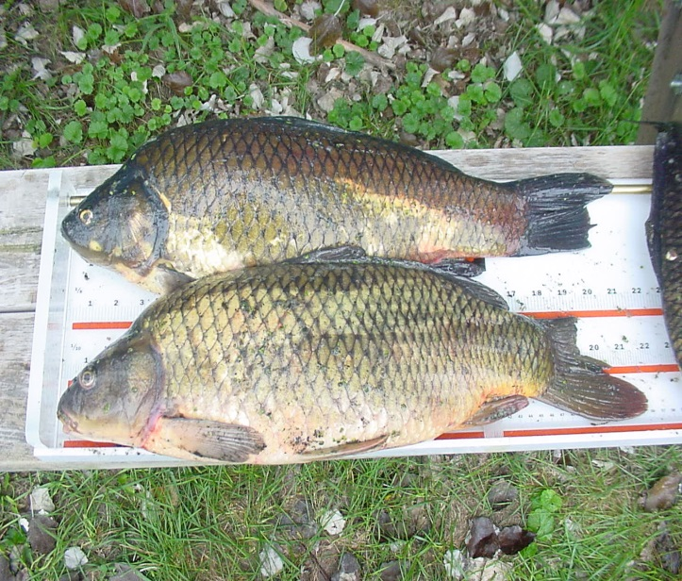
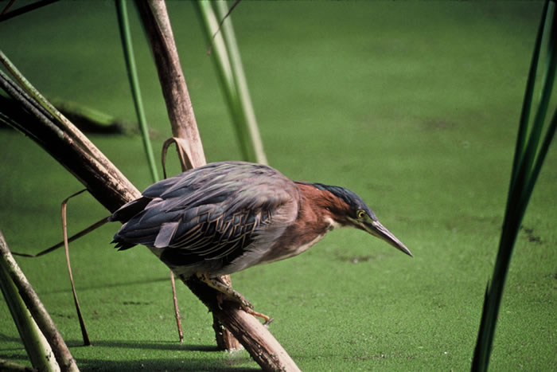
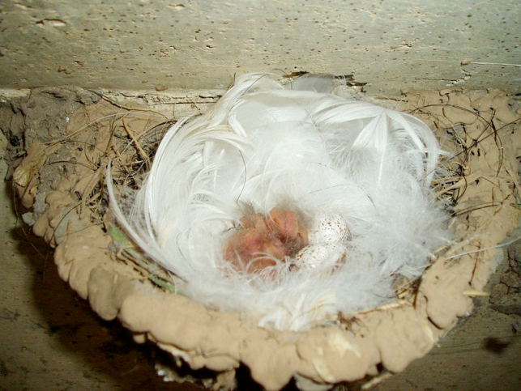
Scientists collect data on…
Fish
Birds and eggs
Notes:
There are many different methods that scientists can use to understand the environment around us. Here are some of the ways scientists gather data on an aquatic ecosystem to understand if it is polluted. Scientists test fish tissue and bird eggs.

Slide 3
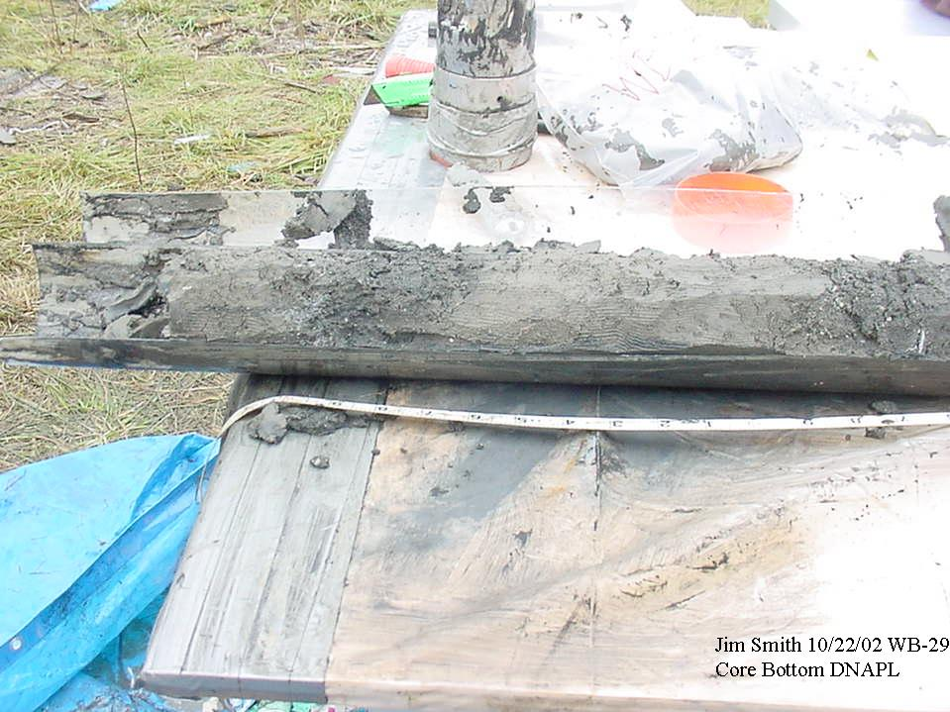
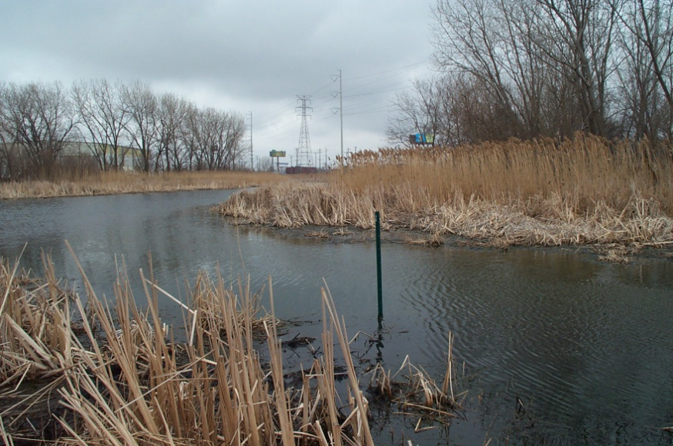
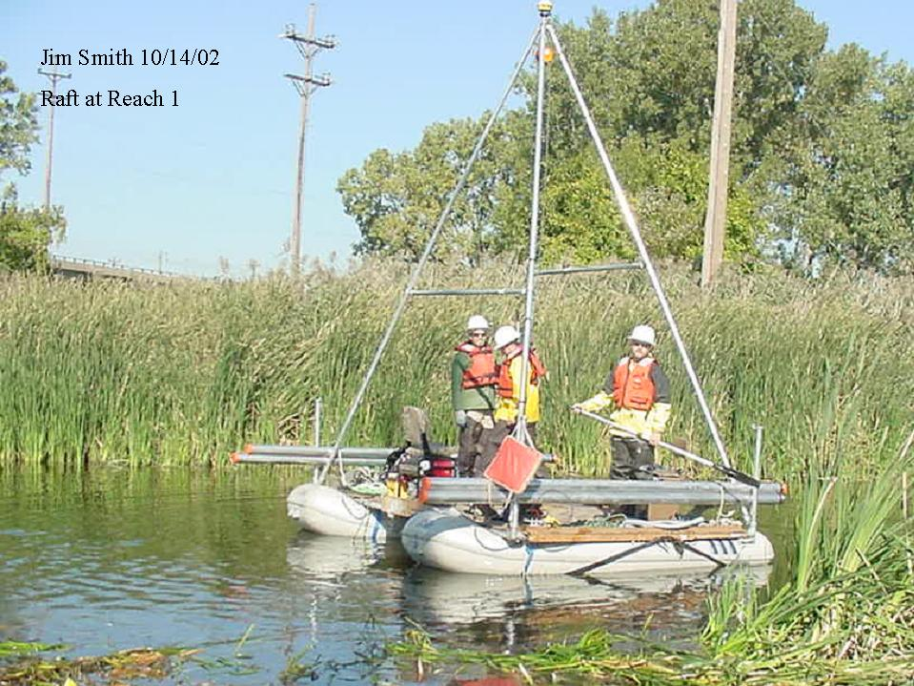
Scientists collect data on…
Water
Sediment
Notes:
Scientists can test the water (just like the classes did in previous lessons) or they can drill cores of sediment out of the river.

Slide 4
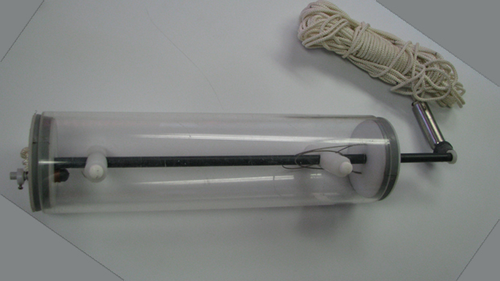
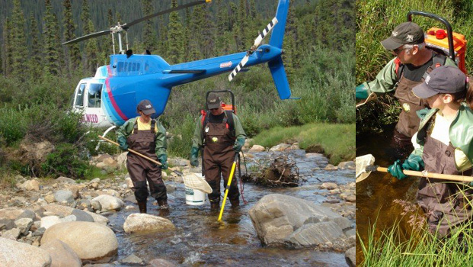
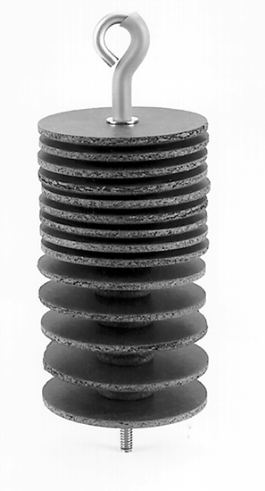
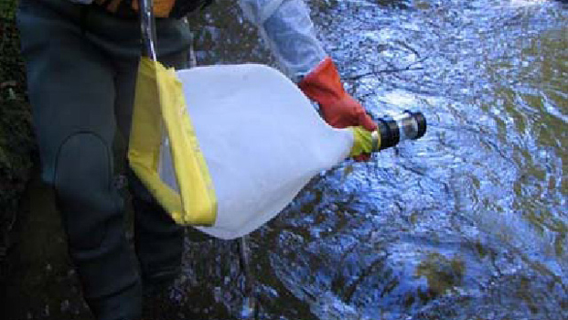
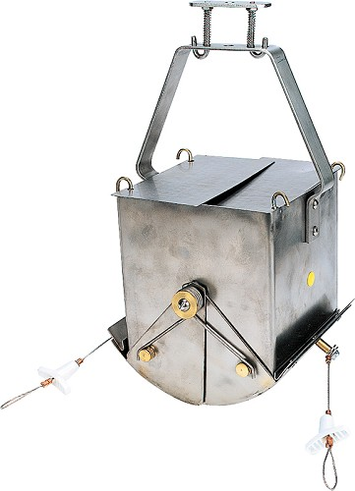
Data collection instruments
Notes:
They use different data collection instruments. Here are some.
The coil is a Hesterdendees, which is an artificial substrate for benthic organisms. A scientist puts the coil in the river or lake, and sediment-dwelling invertebrates make their home on the coil. Scientists can then sample the invertebrates by taking out the coil
The tube is a water sampler, which is a way to collect water.
The net with the yellow rim is a plankton sample.
The helicopter picture shows people with nets sampling .
The bottom right is a box core sediment sampler. It is dropped into a river from a boat and grabs a sample of sediment.

Slide 5
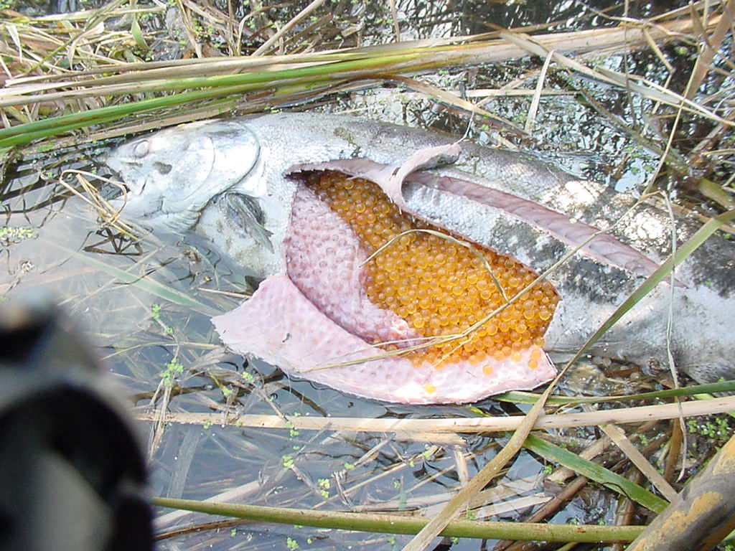
Scientists look for…
Fish tissue
Deformities
Egg shell thinning
Reproductive success
Metals in sediment and water
Semi volatile and volatile organics
PCBs
Oil and grease
Pesticides
Emerging contaminants
Notes:
And this is what the scientists are looking for (reference list).
Once scientists collect their data, they analyze it for trends and make conclusions about the environment. For example, the presence of many of these things are a sign that the environment is degraded and may need to be cleaned up.

Slide 6
Data Reporting and Communication
Data are communicated differently based on the audience
Project Scientist
Project Manager
Decision Maker
General Public
Notes:
Once the scientists have analyzed the data, they make conclusions. They use different communication methods and styles based on their audience to share these conclusions. Here are some of the audiences scientists have to communicate with – fellow project scientists, their supervisor/manager, a decision maker – such as a Congresswoman or other elected official, or the general public.
For example, scientists can tell us if the air is clean. One parameter that scientists look at for air quality is benzene. The presence of high levels of benzene in the air is bad. So scientists collect data on benzene, and they will communicate that differently to different audiences.

Slide 7
Project Scientist
Benzene Ambient Air Sample Results
WB12-A1-091411-VOC-D | 1,2-Dichloropropane | 1 | 9/14/2011 | ND |  | 1 | 11090393
WB12-A1-091411-VOC-D | 1,4-Dioxane | 1 | 9/14/2011 | ND |  | 1 | 11090393
WB12-A1-091411-VOC-D | 2-Butanone | 1 | 9/14/2011 | ND |  | 1 | 11090393
WB12-A1-091411-VOC-D | 2-Hexanone | 1 | 9/14/2011 | ND |  | 1 | 11090393
WB12-A1-091411-VOC-D | 4-Methyl-2-pentanone | 1 | 9/14/2011 | ND |  | 1 | 11090393
WB12-A1-091411-VOC-D | Acetone | 1 | 9/14/2011 | 8.7 | * | 1 | 11090393
WB12-A1-091411-VOC-D | Benzene | 1 | 9/14/2011 | 1.3 |  | 1 | 11090393
WB12-A1-091411-VOC-D | Bromodichloromethane | 1 | 9/14/2011 | ND |  | 1 | 11090393
WB12-A1-091411-VOC-D | Bromomethane | 1 | 9/14/2011 | ND |  | 1 | 11090393
WB12-A1-091411-VOC-D | Carbon disulfide | 1 | 9/14/2011 | ND |  | 1 | 11090393
WB12-A1-091411-VOC-D | Carbon tetrachloride | 1 | 9/14/2011 | ND |  | 1 | 11090393
WB12-A1-091411-VOC-D | Chlorobenzene | 1 | 9/14/2011 | ND |  | 1 | 11090393
WB12-A1-091411-VOC-D | Chloroethane | 1 | 9/14/2011 | ND |  | 1 | 11090393
WB12-A1-091411-VOC-D | Chloroform | 1 | 9/14/2011 | ND |  | 1 | 11090393
WB12-A1-091411-VOC-D | Chloromethane | 1 | 9/14/2011 | 0.8 | J | 1 | 11090393
WB12-A1-091411-VOC-D | cis-1,2-Dichloroethene | 1 | 9/14/2011 | ND |  | 1 | 11090393
WB12-A1-091411-VOC-D | cis-1,3-Dichloropropene | 1 | 9/14/2011 | ND |  | 1 | 11090393
WB12-A1-091411-VOC-D | Cyclohexane | 1 | 9/14/2011 | ND |  | 1 | 11090393
WB12-A1-091411-VOC-D | Dibromochloromethane | 1 | 9/14/2011 | ND |  | 1 | 11090393
WB12-A1-091411-VOC-D | Dichlorodifluoromethane | 1 | 9/14/2011 | 2.3 |  | 1 | 11090393
WB12-A1-091411-VOC-D | Ethylbenzene | 1 | 9/14/2011 | ND |  | 1 | 11090393
WB12-A1-091411-VOC-D | Freon-113 | 1 | 9/14/2011 | ND |  | 1 | 11090393
WB12-A1-091411-VOC-D | m,p-Xylene | 1 | 9/14/2011 | 1.4 | J | 1 | 11090393
WB12-A1-091411-VOC-D | Methyl tert-butyl ether | 1 | 9/14/2011 | ND |  | 1 | 11090393
WB12-A1-091411-VOC-D | Methylcyclohexane | 1 | 9/14/2011 | ND | * | 1 | 11090393
WB12-A1-091411-VOC-D | Methylene chloride | 1 | 9/14/2011 | ND |  | 1 | 11090393
WB12-A1-091411-VOC-D | o-Xylene | 1 | 9/14/2011 | ND |  | 1 | 11090393
WB12-A1-091411-VOC-D | Styrene | 1 | 9/14/2011 | ND |  | 1 | 11090393
WB12-A1-091411-VOC-D | Tetrachloroethene | 1 | 9/14/2011 | ND |  | 1 | 11090393
WB12-A1-091411-VOC-D | Toluene | 1 | 9/14/2011 | 2.3 |  | 1 | 11090393
WB12-A1-091411-VOC-D | trans-1,2-Dichloroethene | 1 | 9/14/2011 | ND |  | 1 | 11090393
WB12-A1-091411-VOC-D | trans-1,3-Dichloropropene | 1 | 9/14/2011 | ND |  | 1 | 11090393
WB12-A1-091411-VOC-D | Trichloroethene | 1 | 9/14/2011 | ND |  | 1 | 11090393
WB12-A1-091411-VOC-D | Trichlorofluoromethane | 1 | 9/14/2011 | 1.2 | J | 1 | 11090393
WB12-A1-091411-VOC-D | Vinyl chloride | 1 | 9/14/2011 | ND |  |  | 11090393
WB12-A2-091411-VOC | 1,1,1-Trichloroethane | 2 | 9/14/2011 | ND |  |  | 11090393
WB12-A2-091411-VOC | 1,1,2-Trichloroethane | 2 | 9/14/2011 | ND |  |  | 11090393
WB12-A2-091411-VOC | 1,1-Dichloroethane | 2 | 9/14/2011 | ND |  |  | 11090393
WB12-A2-091411-VOC | 1,1-Dichloroethene | 2 | 9/14/2011 | ND |  |  | 11090393
WB12-A2-091411-VOC | 1,2-Dibromoethane | 2 | 9/14/2011 | ND |  |  | 11090393
WB12-A2-091411-VOC | 1,2-Dichloroethane | 2 | 9/14/2011 | ND |  |  | 11090393
WB12-A2-091411-VOC | 1,2-Dichloropropane | 2 | 9/14/2011 | ND |  |  | 11090393
WB12-A2-091411-VOC | 1,4-Dioxane | 2 | 9/14/2011 | ND |  |  | 11090393
WB12-A2-091411-VOC | 2-Butanone | 2 | 9/14/2011 | 1.3 | J |  | 11090393
WB12-A2-091411-VOC | 2-Hexanone | 2 | 9/14/2011 | ND |  |  | 11090393
WB12-A2-091411-VOC | 4-Methyl-2-pentanone | 2 | 9/14/2011 | ND |  |  | 11090393
WB12-A2-091411-VOC | Acetone | 2 | 9/14/2011 | 12 | * |  | 11090393
WB12-A2-091411-VOC | Benzene | 2 | 9/14/2011 | 1.2 |  |  | 11090393
WB12-A2-091411-VOC | Bromodichloromethane | 2 | 9/14/2011 | ND |  |  | 11090393
WB12-A2-091411-VOC | Bromomethane | 2 | 9/14/2011 | ND |  |  | 11090393
WB12-A2-091411-VOC | Carbon disulfide | 2 | 9/14/2011 | ND |  |  | 11090393
WB12-A2-091411-VOC | Carbon tetrachloride | 2 | 9/14/2011 | ND |  |  | 11090393
WB12-A2-091411-VOC | Chlorobenzene | 2 | 9/14/2011 | ND |  |  | 11090393
WB12-A2-091411-VOC | Chloroethane | 2 | 9/14/2011 | ND |  |  | 11090393
WB12-A2-091411-VOC | Chloroform | 2 | 9/14/2011 | ND |  |  | 11090393
WB12-A2-091411-VOC | Chloromethane | 2 | 9/14/2011 | 0.84 | J |  | 11090393
WB12-A2-091411-VOC | cis-1,2-Dichloroethene | 2 | 9/14/2011 | ND |  |  | 11090393
WB12-A2-091411-VOC | cis-1,3-Dichloropropene | 2 | 9/14/2011 | ND |  |  | 11090393
WB12-A2-091411-VOC | Cyclohexane | 2 | 9/14/2011 | ND |  |  | 11090393
WB12-A2-091411-VOC | Dibromochloromethane | 2 | 9/14/2011 | ND |  |  | 11090393
WB12-A2-091411-VOC | Dichlorodifluoromethane | 2 | 9/14/2011 | 2.3 |  |  | 11090393
WB12-A2-091411-VOC | Ethylbenzene | 2 | 9/14/2011 | ND |  |  | 11090393
WB12-A2-091411-VOC | Freon-113 | 2 | 9/14/2011 | ND |  |  | 11090393
WB12-A2-091411-VOC | m,p-Xylene | 2 | 9/14/2011 | 1.4 | J |  | 11090393
WB12-A1-091411-VOC-D | 1,2-Dichloropropane | 1 | 9/14/2011 | ND |  | 1 | 11090393
WB12-A1-091411-VOC-D | 1,4-Dioxane | 1 | 9/14/2011 | ND |  | 1 | 11090393
WB12-A1-091411-VOC-D | 2-Butanone | 1 | 9/14/2011 | ND |  | 1 | 11090393
WB12-A1-091411-VOC-D | 2-Hexanone | 1 | 9/14/2011 | ND |  | 1 | 11090393
WB12-A1-091411-VOC-D | 4-Methyl-2-pentanone | 1 | 9/14/2011 | ND |  | 1 | 11090393
WB12-A1-091411-VOC-D | Acetone | 1 | 9/14/2011 | 8.7 | * | 1 | 11090393
WB12-A1-091411-VOC-D | Benzene | 1 | 9/14/2011 | 1.3 |  | 1 | 11090393
WB12-A1-091411-VOC-D | Bromodichloromethane | 1 | 9/14/2011 | ND |  | 1 | 11090393
WB12-A1-091411-VOC-D | Bromomethane | 1 | 9/14/2011 | ND |  | 1 | 11090393
WB12-A1-091411-VOC-D | Carbon disulfide | 1 | 9/14/2011 | ND |  | 1 | 11090393
WB12-A1-091411-VOC-D | Carbon tetrachloride | 1 | 9/14/2011 | ND |  | 1 | 11090393
WB12-A1-091411-VOC-D | Chlorobenzene | 1 | 9/14/2011 | ND |  | 1 | 11090393
WB12-A1-091411-VOC-D | Chloroethane | 1 | 9/14/2011 | ND |  | 1 | 11090393
WB12-A1-091411-VOC-D | Chloroform | 1 | 9/14/2011 | ND |  | 1 | 11090393
WB12-A1-091411-VOC-D | Chloromethane | 1 | 9/14/2011 | 0.8 | J | 1 | 11090393
WB12-A1-091411-VOC-D | cis-1,2-Dichloroethene | 1 | 9/14/2011 | ND |  | 1 | 11090393
WB12-A1-091411-VOC-D | cis-1,3-Dichloropropene | 1 | 9/14/2011 | ND |  | 1 | 11090393
WB12-A1-091411-VOC-D | Cyclohexane | 1 | 9/14/2011 | ND |  | 1 | 11090393
WB12-A1-091411-VOC-D | Dibromochloromethane | 1 | 9/14/2011 | ND |  | 1 | 11090393
WB12-A1-091411-VOC-D | Dichlorodifluoromethane | 1 | 9/14/2011 | 2.3 |  | 1 | 11090393
WB12-A1-091411-VOC-D | Ethylbenzene | 1 | 9/14/2011 | ND |  | 1 | 11090393
WB12-A1-091411-VOC-D | Freon-113 | 1 | 9/14/2011 | ND |  | 1 | 11090393
WB12-A1-091411-VOC-D | m,p-Xylene | 1 | 9/14/2011 | 1.4 | J | 1 | 11090393
WB12-A1-091411-VOC-D | Methyl tert-butyl ether | 1 | 9/14/2011 | ND |  | 1 | 11090393
WB12-A1-091411-VOC-D | Methylcyclohexane | 1 | 9/14/2011 | ND | * | 1 | 11090393
WB12-A1-091411-VOC-D | Methylene chloride | 1 | 9/14/2011 | ND |  | 1 | 11090393
WB12-A1-091411-VOC-D | o-Xylene | 1 | 9/14/2011 | ND |  | 1 | 11090393
WB12-A1-091411-VOC-D | Styrene | 1 | 9/14/2011 | ND |  | 1 | 11090393
WB12-A1-091411-VOC-D | Tetrachloroethene | 1 | 9/14/2011 | ND |  | 1 | 11090393
WB12-A1-091411-VOC-D | Toluene | 1 | 9/14/2011 | 2.3 |  | 1 | 11090393
WB12-A1-091411-VOC-D | trans-1,2-Dichloroethene | 1 | 9/14/2011 | ND |  | 1 | 11090393
WB12-A1-091411-VOC-D | trans-1,3-Dichloropropene | 1 | 9/14/2011 | ND |  | 1 | 11090393
WB12-A1-091411-VOC-D | Trichloroethene | 1 | 9/14/2011 | ND |  | 1 | 11090393
WB12-A1-091411-VOC-D | Trichlorofluoromethane | 1 | 9/14/2011 | 1.2 | J | 1 | 11090393
WB12-A1-091411-VOC-D | Vinyl chloride | 1 | 9/14/2011 | ND |  |  | 11090393
WB12-A2-091411-VOC | 1,1,1-Trichloroethane | 2 | 9/14/2011 | ND |  |  | 11090393
WB12-A2-091411-VOC | 1,1,2-Trichloroethane | 2 | 9/14/2011 | ND |  |  | 11090393
WB12-A2-091411-VOC | 1,1-Dichloroethane | 2 | 9/14/2011 | ND |  |  | 11090393
WB12-A2-091411-VOC | 1,1-Dichloroethene | 2 | 9/14/2011 | ND |  |  | 11090393
WB12-A2-091411-VOC | 1,2-Dibromoethane | 2 | 9/14/2011 | ND |  |  | 11090393
WB12-A2-091411-VOC | 1,2-Dichloroethane | 2 | 9/14/2011 | ND |  |  | 11090393
WB12-A2-091411-VOC | 1,2-Dichloropropane | 2 | 9/14/2011 | ND |  |  | 11090393
WB12-A2-091411-VOC | 1,4-Dioxane | 2 | 9/14/2011 | ND |  |  | 11090393
WB12-A2-091411-VOC | 2-Butanone | 2 | 9/14/2011 | 1.3 | J |  | 11090393
WB12-A2-091411-VOC | 2-Hexanone | 2 | 9/14/2011 | ND |  |  | 11090393
WB12-A2-091411-VOC | 4-Methyl-2-pentanone | 2 | 9/14/2011 | ND |  |  | 11090393
WB12-A2-091411-VOC | Acetone | 2 | 9/14/2011 | 12 | * |  | 11090393
WB12-A2-091411-VOC | Benzene | 2 | 9/14/2011 | 1.2 |  |  | 11090393
WB12-A2-091411-VOC | Bromodichloromethane | 2 | 9/14/2011 | ND |  |  | 11090393
WB12-A2-091411-VOC | Bromomethane | 2 | 9/14/2011 | ND |  |  | 11090393
WB12-A2-091411-VOC | Carbon disulfide | 2 | 9/14/2011 | ND |  |  | 11090393
WB12-A2-091411-VOC | Carbon tetrachloride | 2 | 9/14/2011 | ND |  |  | 11090393
WB12-A2-091411-VOC | Chlorobenzene | 2 | 9/14/2011 | ND |  |  | 11090393
WB12-A2-091411-VOC | Chloroethane | 2 | 9/14/2011 | ND |  |  | 11090393
WB12-A2-091411-VOC | Chloroform | 2 | 9/14/2011 | ND |  |  | 11090393
WB12-A2-091411-VOC | Chloromethane | 2 | 9/14/2011 | 0.84 | J |  | 11090393
WB12-A2-091411-VOC | cis-1,2-Dichloroethene | 2 | 9/14/2011 | ND |  |  | 11090393
WB12-A2-091411-VOC | cis-1,3-Dichloropropene | 2 | 9/14/2011 | ND |  |  | 11090393
WB12-A2-091411-VOC | Cyclohexane | 2 | 9/14/2011 | ND |  |  | 11090393
WB12-A2-091411-VOC | Dibromochloromethane | 2 | 9/14/2011 | ND |  |  | 11090393
WB12-A2-091411-VOC | Dichlorodifluoromethane | 2 | 9/14/2011 | 2.3 |  |  | 11090393
WB12-A2-091411-VOC | Ethylbenzene | 2 | 9/14/2011 | ND |  |  | 11090393
WB12-A2-091411-VOC | Freon-113 | 2 | 9/14/2011 | ND |  |  | 11090393
WB12-A2-091411-VOC | m,p-Xylene | 2 | 9/14/2011 | 1.4 | J |  | 11090393
WB12-A1-091411-VOC-D | 1,2-Dichloropropane | 1 | 9/14/2011 | ND |  | 1 | 11090393
WB12-A1-091411-VOC-D | 1,4-Dioxane | 1 | 9/14/2011 | ND |  | 1 | 11090393
WB12-A1-091411-VOC-D | 2-Butanone | 1 | 9/14/2011 | ND |  | 1 | 11090393
WB12-A1-091411-VOC-D | 2-Hexanone | 1 | 9/14/2011 | ND |  | 1 | 11090393
WB12-A1-091411-VOC-D | 4-Methyl-2-pentanone | 1 | 9/14/2011 | ND |  | 1 | 11090393
WB12-A1-091411-VOC-D | Acetone | 1 | 9/14/2011 | 8.7 | * | 1 | 11090393
WB12-A1-091411-VOC-D | Benzene | 1 | 9/14/2011 | 1.3 |  | 1 | 11090393
WB12-A1-091411-VOC-D | Bromodichloromethane | 1 | 9/14/2011 | ND |  | 1 | 11090393
WB12-A1-091411-VOC-D | Bromomethane | 1 | 9/14/2011 | ND |  | 1 | 11090393
WB12-A1-091411-VOC-D | Carbon disulfide | 1 | 9/14/2011 | ND |  | 1 | 11090393
WB12-A1-091411-VOC-D | Carbon tetrachloride | 1 | 9/14/2011 | ND |  | 1 | 11090393
WB12-A1-091411-VOC-D | Chlorobenzene | 1 | 9/14/2011 | ND |  | 1 | 11090393
WB12-A1-091411-VOC-D | Chloroethane | 1 | 9/14/2011 | ND |  | 1 | 11090393
WB12-A1-091411-VOC-D | Chloroform | 1 | 9/14/2011 | ND |  | 1 | 11090393
WB12-A1-091411-VOC-D | Chloromethane | 1 | 9/14/2011 | 0.8 | J | 1 | 11090393
WB12-A1-091411-VOC-D | cis-1,2-Dichloroethene | 1 | 9/14/2011 | ND |  | 1 | 11090393
WB12-A1-091411-VOC-D | cis-1,3-Dichloropropene | 1 | 9/14/2011 | ND |  | 1 | 11090393
WB12-A1-091411-VOC-D | Cyclohexane | 1 | 9/14/2011 | ND |  | 1 | 11090393
WB12-A1-091411-VOC-D | Dibromochloromethane | 1 | 9/14/2011 | ND |  | 1 | 11090393
WB12-A1-091411-VOC-D | Dichlorodifluoromethane | 1 | 9/14/2011 | 2.3 |  | 1 | 11090393
WB12-A1-091411-VOC-D | Ethylbenzene | 1 | 9/14/2011 | ND |  | 1 | 11090393
WB12-A1-091411-VOC-D | Freon-113 | 1 | 9/14/2011 | ND |  | 1 | 11090393
WB12-A1-091411-VOC-D | m,p-Xylene | 1 | 9/14/2011 | 1.4 | J | 1 | 11090393
WB12-A1-091411-VOC-D | Methyl tert-butyl ether | 1 | 9/14/2011 | ND |  | 1 | 11090393
WB12-A1-091411-VOC-D | Methylcyclohexane | 1 | 9/14/2011 | ND | * | 1 | 11090393
WB12-A1-091411-VOC-D | Methylene chloride | 1 | 9/14/2011 | ND |  | 1 | 11090393
WB12-A1-091411-VOC-D | o-Xylene | 1 | 9/14/2011 | ND |  | 1 | 11090393
WB12-A1-091411-VOC-D | Styrene | 1 | 9/14/2011 | ND |  | 1 | 11090393
WB12-A1-091411-VOC-D | Tetrachloroethene | 1 | 9/14/2011 | ND |  | 1 | 11090393
WB12-A1-091411-VOC-D | Toluene | 1 | 9/14/2011 | 2.3 |  | 1 | 11090393
WB12-A1-091411-VOC-D | trans-1,2-Dichloroethene | 1 | 9/14/2011 | ND |  | 1 | 11090393
WB12-A1-091411-VOC-D | trans-1,3-Dichloropropene | 1 | 9/14/2011 | ND |  | 1 | 11090393
WB12-A1-091411-VOC-D | Trichloroethene | 1 | 9/14/2011 | ND |  | 1 | 11090393
WB12-A1-091411-VOC-D | Trichlorofluoromethane | 1 | 9/14/2011 | 1.2 | J | 1 | 11090393
WB12-A1-091411-VOC-D | Vinyl chloride | 1 | 9/14/2011 | ND |  |  | 11090393
WB12-A2-091411-VOC | 1,1,1-Trichloroethane | 2 | 9/14/2011 | ND |  |  | 11090393
WB12-A2-091411-VOC | 1,1,2-Trichloroethane | 2 | 9/14/2011 | ND |  |  | 11090393
WB12-A2-091411-VOC | 1,1-Dichloroethane | 2 | 9/14/2011 | ND |  |  | 11090393
WB12-A2-091411-VOC | 1,1-Dichloroethene | 2 | 9/14/2011 | ND |  |  | 11090393
WB12-A2-091411-VOC | 1,2-Dibromoethane | 2 | 9/14/2011 | ND |  |  | 11090393
WB12-A2-091411-VOC | 1,2-Dichloroethane | 2 | 9/14/2011 | ND |  |  | 11090393
WB12-A2-091411-VOC | 1,2-Dichloropropane | 2 | 9/14/2011 | ND |  |  | 11090393
WB12-A2-091411-VOC | 1,4-Dioxane | 2 | 9/14/2011 | ND |  |  | 11090393
WB12-A2-091411-VOC | 2-Butanone | 2 | 9/14/2011 | 1.3 | J |  | 11090393
WB12-A2-091411-VOC | 2-Hexanone | 2 | 9/14/2011 | ND |  |  | 11090393
WB12-A2-091411-VOC | 4-Methyl-2-pentanone | 2 | 9/14/2011 | ND |  |  | 11090393
WB12-A2-091411-VOC | Acetone | 2 | 9/14/2011 | 12 | * |  | 11090393
WB12-A2-091411-VOC | Benzene | 2 | 9/14/2011 | 1.2 |  |  | 11090393
WB12-A2-091411-VOC | Bromodichloromethane | 2 | 9/14/2011 | ND |  |  | 11090393
WB12-A2-091411-VOC | Bromomethane | 2 | 9/14/2011 | ND |  |  | 11090393
WB12-A2-091411-VOC | Carbon disulfide | 2 | 9/14/2011 | ND |  |  | 11090393
WB12-A2-091411-VOC | Carbon tetrachloride | 2 | 9/14/2011 | ND |  |  | 11090393
WB12-A2-091411-VOC | Chlorobenzene | 2 | 9/14/2011 | ND |  |  | 11090393
WB12-A2-091411-VOC | Chloroethane | 2 | 9/14/2011 | ND |  |  | 11090393
WB12-A2-091411-VOC | Chloroform | 2 | 9/14/2011 | ND |  |  | 11090393
WB12-A2-091411-VOC | Chloromethane | 2 | 9/14/2011 | 0.84 | J |  | 11090393
WB12-A2-091411-VOC | cis-1,2-Dichloroethene | 2 | 9/14/2011 | ND |  |  | 11090393
WB12-A2-091411-VOC | cis-1,3-Dichloropropene | 2 | 9/14/2011 | ND |  |  | 11090393
WB12-A2-091411-VOC | Cyclohexane | 2 | 9/14/2011 | ND |  |  | 11090393
WB12-A2-091411-VOC | Dibromochloromethane | 2 | 9/14/2011 | ND |  |  | 11090393
WB12-A2-091411-VOC | Dichlorodifluoromethane | 2 | 9/14/2011 | 2.3 |  |  | 11090393
WB12-A2-091411-VOC | Ethylbenzene | 2 | 9/14/2011 | ND |  |  | 11090393
WB12-A2-091411-VOC | Freon-113 | 2 | 9/14/2011 | ND |  |  | 11090393
WB12-A2-091411-VOC | m,p-Xylene | 2 | 9/14/2011 | 1.4 | J |  | 11090393
Notes:
Does this look like a good way to communicate with the public about benzene? Why or why not?
Who might this be an appropriate person to receive these data?
Discuss that this would be appropriate to share with fellow project scientists because fellow scientists may need raw data for analysis.

Slide 8
Project Manager
Benzene Ambient Air Sample Results
Date | L-1 | L-2 | L-3 | L-10 | L-7 | L-8 | RSL | ISL
11-Oct | 0.84 | 0.69 | 0.75
29-Sep | 1.4 | 0.7 | 0 | 0 | 0.66 | 0.61 | 0.31 | 2
22-Sep | 0 | 0 | 0 | 0 | 0 | 0 | 0.31 | 2
14-Sep | 1.4 | 1.2 | 1.1 | 0.99 | 1.1 | 1.2 | 0.31 | 2
6-Sep | 0 | 0 | 0 | 0 | 0 | 0 | 0.31 | 2
1-Sep | 1.2 | 0.65 | 0 | 0 | 0 | 0 | 0.31 | 2
30-Aug | 0 | 0 | 0 | 0 | 0 | 0 | 0.31 | 2
25-Aug | 1 | 0 | 0 | 0 | 0 | 0 | 0.31 | 2
24-Aug | 1.2 | 0 | 0 | 0 |  |  | 0.31 | 2
18-Aug | 0.71 | 0 | 0.57 | 0 | 0 | 0 | 0.31 | 2
16-Aug | 0 | 0 | 0 | 0 | 0 | 0 | 0.31 | 2
11-Aug | 0.82 | 0.62 | 0.58 | 0 | 0 | 0.72 | 0.31 | 2
10-Aug | 0 | 0 | 0 | 0 | 0 |  | 0.31 | 2
5-Aug | 1.4 | 0.79 | 0.89 | 0.73 | 0.69 | 0.85 | 0.31 | 2
2-Aug | 0.68 | 0 | 0 | 0 | 0 | 0 | 0.31 | 2
25-Jul | 0.71 | 0.72 | 0.63 | 0 | 0 | 0 | 0.31 | 2
20-Jul | 1 | 0 | 0 | 0 | 0 | 0 | 0.31 | 2
14-Jul | 0.63 | 0 | 0 |  | 0 | 0 | 0.31 | 2
13-Jul | 3.5 | 0 | 0 |  | 0 | 0 | 0.31 | 2
7-Jul | 0.66 | 0.66 | 0.75 | 0.5 | 0 | 0 | 0.31 | 2
5-Jul | 0.79 | 0.83 | 0.72 |  | 0.79 | 0.75 | 0.31 | 2
30-Jun | 0 | 0 | 0 |  | 0 | 0 | 0.31 | 2
28-Jun | 0 | 0 | 0 |  | 0 | 0 | 0.31 | 2
22-Jun | 0 | 0 | 0 |  | 0 | 0 | 0.31 | 2
17-Jun | 0.66 | 0.65 | 0.73 |  | 0.74 | 0.63 | 0.31 | 2
14-Jun | 0 | 0 | 0 |  | 0 | 0 | 0.31 | 2
Notes:
The manager of the project is probably pretty busy. They are scientists, so they’re going to want to see the data, but it’s good to show them graphically or in a smaller table format that your representation shows enough summary data to demonstrate a trend. For example, you can plot the mean, median, or mode of a large collection of samples on a graph from different locations or times to show a trend.

Slide 9
Decision Maker/General Public
Air Quality Results for Benzene
Higher than industrial screening level
Notes:
Both decision makers and the general public need simplified results. It is a best practice to assume a low level of scientific understanding. Graphs that are more simplified and have symbols that point out trends or problems work well. In this example, using a graph shows that a scientific approach led us to the conclusion, but an arrow helps quickly identify what the decision maker or public should pay attention to.

Slide 10
Decision Maker/General Public
Air Quality Results
Parameters |  | Location 1 | Location 3 | Location 5 | Location 6
 |  | RA Location |  | RA Location | RA Location
 |  | Industrial
PCBs
Pesticides
PAHs
Metal |  |  |  | N/A | N/A
Mercury |  |  |  | N/A | N/A
Benzene |  |  |  | N/A | N/A
\
For Industrial Locations:
 |  | Higher than industrial screening level
 |  | Higher than background and lower than industrial screening level
 |  | Equal to or below background level
Notes:
Similarly, simple tables are also great for decision makers and the general public. Color coding helps the decision maker or public make a conclusion quickly about the data.

