Slide 1
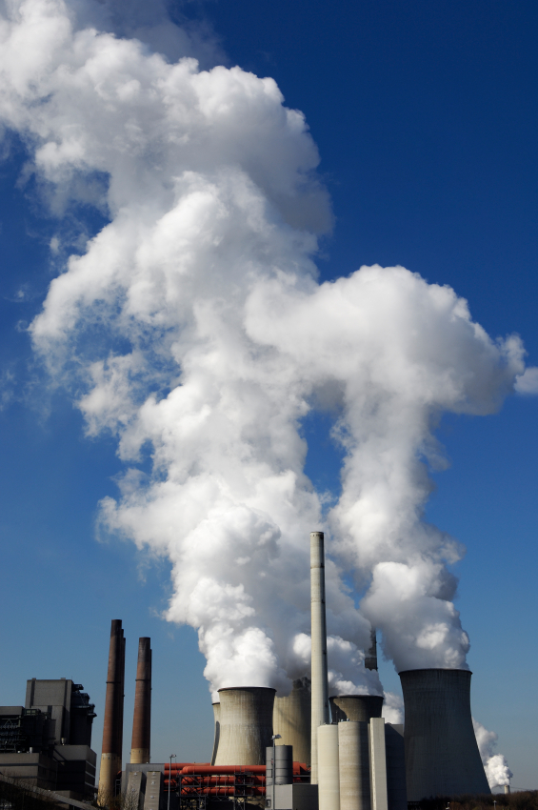
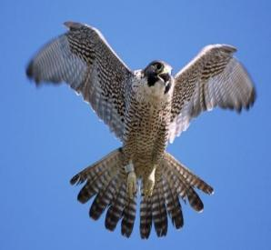
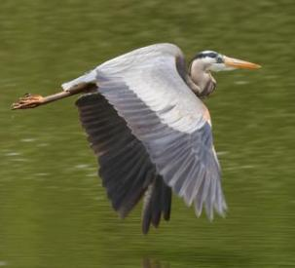
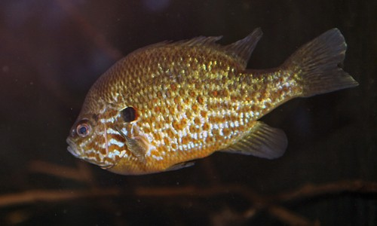
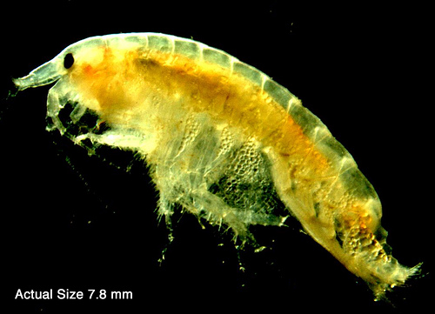
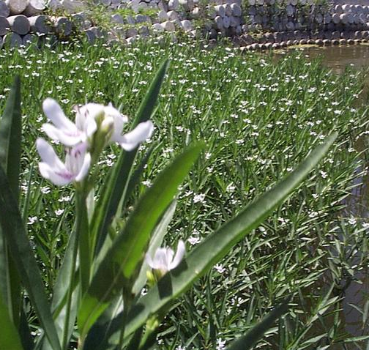
POLLUTION
Notes:
Note to teachers: Use resources on the organisms that are specific to your Area of Concern and insert them into this PowerPoint. Other organisms than the ones in this document may be better representative of your Area of Concern.

Slide 2
Vocabulary
Pollution
Habitat
Ecosystem
Wetland
Sediment
Food chain
Benthos/Benthic
Bioaccumulation
Notes:
Ask them if they remember any of the terms (they likely won’t know benthos or bioaccumulation).
Ask what the difference is between an ecosystem and a habitat.
Tie in the food chain with the picture.

Slide 3
Pollution
What is pollution?
What does pollution look like? Smell like? Taste like?
What are examples of pollution near your school?
What does pollution do to an animal’s habitat?
Notes:
Repeat their definition of pollution. Ask the questions on the slide.

Slide 4
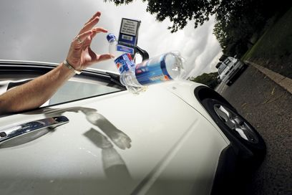
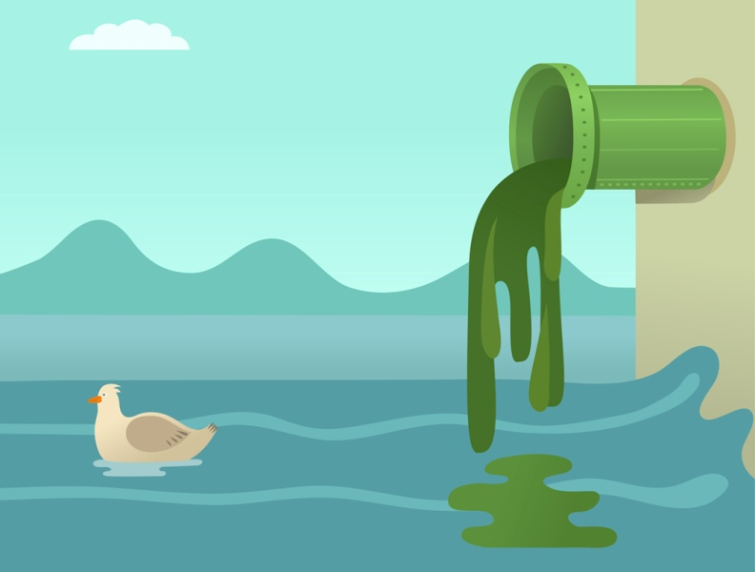
Where does pollution come from?
Notes:
Pollution comes from lots of different places. Ask them: Where does it come from?
Examples
Smoke, car exhaust – pollutes the air
Fertilizers that farmers spray on their crops, sewers, oil on the ground at a gas station – when it rains, these flow across the land and into the water - pollutes the water
Garbage, litter– pollutes the land

Slide 5
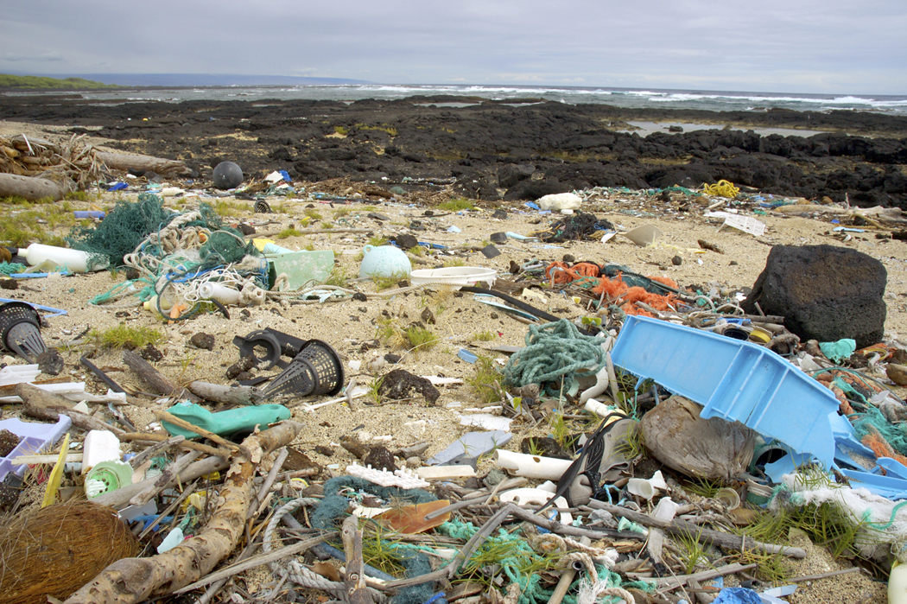
Is this ecosystem polluted?
Notes:
Ask if the ecosystem is polluted. Yes, what is the pollution that you can see in this picture? What kinds of plants or animals might be affected by the pollution?
Land pollution - garbage

Slide 6
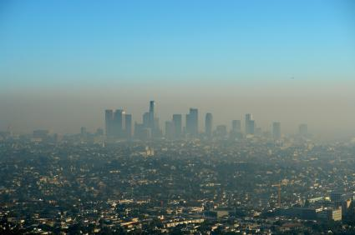
Is this ecosystem polluted?
Notes:
Ask if the ecosystem is polluted. Yes, what is the pollution that you can see in this picture? What kinds of plants or animals might be affected by the pollution?
Air pollution – smog. China has a lot of people. The United States has a lot of laws to protect the environment, but China does not. Factories and cars can put a lot of smoke and chemicals in the air.

Slide 7
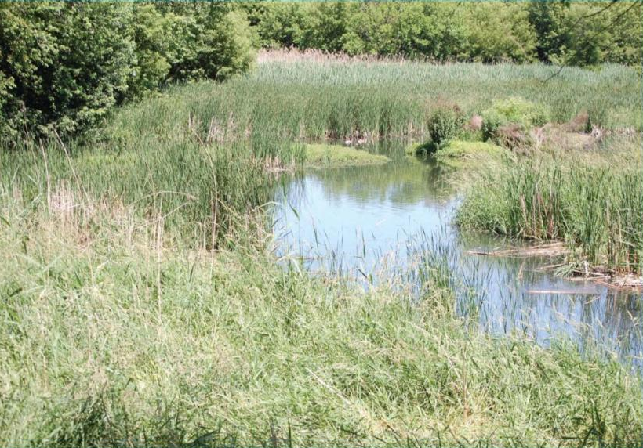
Is this ecosystem polluted?
Notes:
Ask if the ecosystem is polluted. Yes, it is polluted! Can you believe it? This is a wetland before it got cleaned up. In this picture, you cannot see the polluted part.
The pollution is affecting a part of the ecosystem we have not talked about yet today, but it’s something you learned about in the habitat lesson. Any guesses? Remember, you can’t see it in the picture.

Slide 8
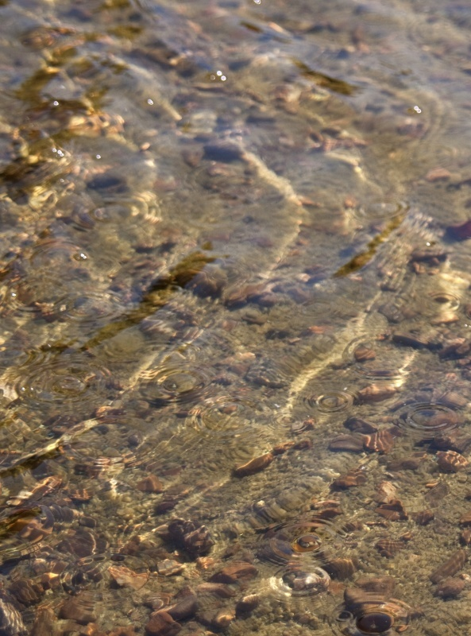
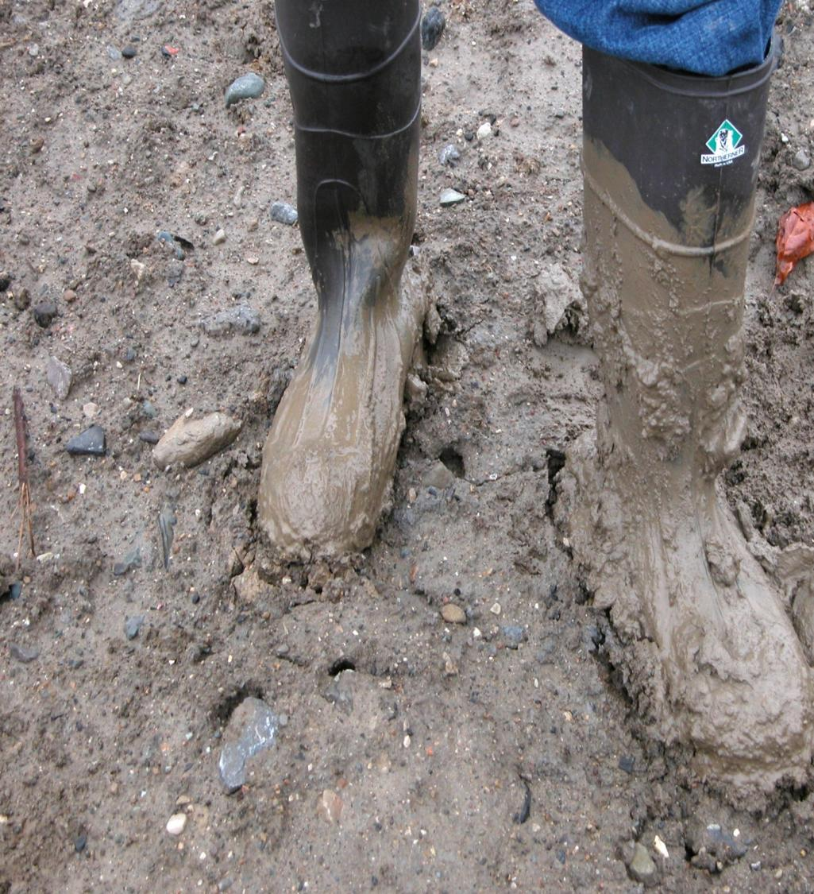
sediment
Notes:
The sediment in this ecosystem is polluted.

Slide 9
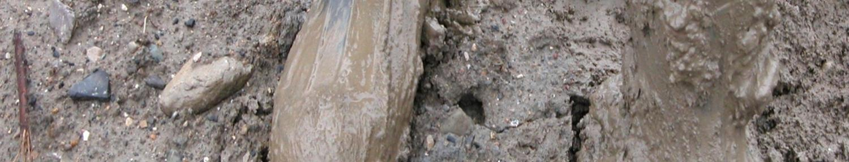
What is sediment?
The mud at the bottom of a body of water
The foundation of the ecosystem
Home for tiny critters and plants (benthos)
Notes:
Sediment is the mud at the bottom of a body of water. It’s the squishy stuff between your toes when you go swimming in a lake or river.
Sediment is the foundation, the base, or the bottom of the ecosystem. It is a habitat (home) for the community of tiny critters and plants (called benthos). Fish eat those critters or benthic organisms. Benthic organisms can then feed on decomposed plants, such as the American water-willow.

Slide 10

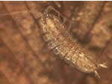

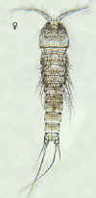

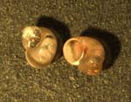
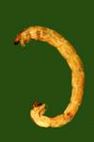

Benthos
Community of tiny critters and plants that live in the sediment
Notes:
Here are some different pictures that represent benthos (only the zooplankton, or critters, are represented here). Take a good look at these pictures. Do benthic organisms remind you of anything?

Slide 11
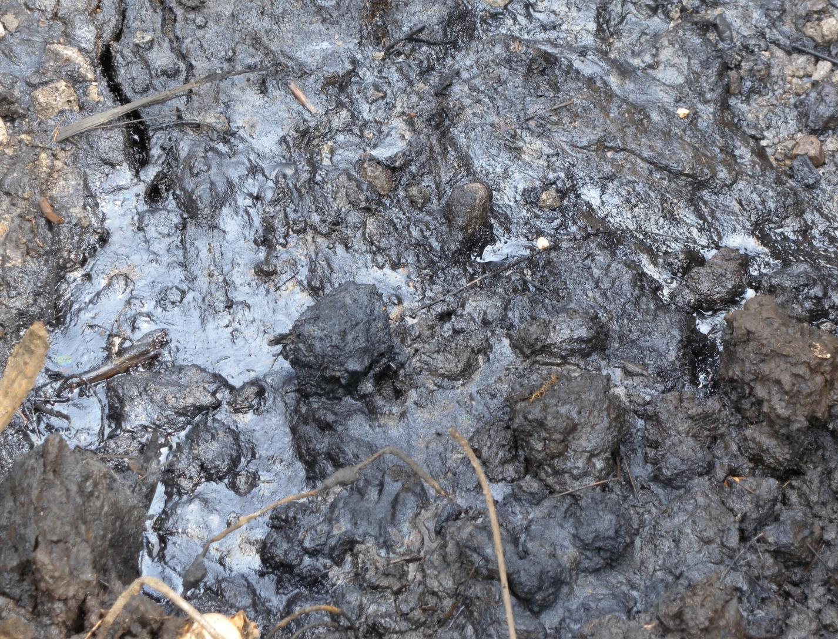
clean sediment
polluted sediment
Notes:
Here are two pictures of sediment. One is polluted and one is not. This picture of polluted sediment is from a marsh in the Great Lakes. Pollution can remain in the environment for decades after it got there. How did most of the pollution get into our Area of Concern?
*The likely answer is: From many decades ago, maybe even centuries, before environmental laws made it illegal for people to pollute. So even though this pollution is really old, it still remains in the Area of Concern.
Ask them - And what happens to the benthic community if it lives in polluted sediment?
If sediment is polluted, then the benthic community become polluted.

Slide 12
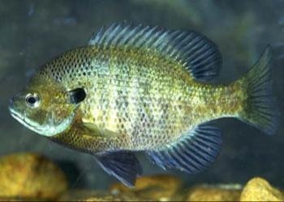
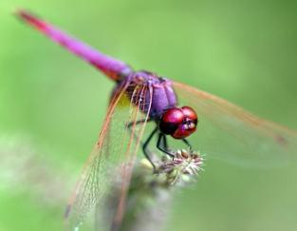
Pollution
Polluted Sediment = Polluted Benthos
Notes:
Ask them – What is happening in this food chain? Who eats whom?
As we said, some fish eat bethnic organisms. If the benthic community is in polluted sediment, the benthos become polluted. This means the fish are eating a polluted benthic community!
Pollution passes through the food chain, and harms all the members of the food chain.

Slide 13
Bioaccumulation
When a fish eats polluted benthic organisms, that pollution goes into the fish and can remain a long time. If the fish eats more polluted benthic organisms, the pollution inside the fish increases. This is bioaccumulation.
Bioaccumulation demonstration
Notes:
We said the pollution passes up the food chain. The pollution increases as it moves up the food chain. This happens because of something called bioaccumulation. Benthic organisms that live in contaminated sediment ingest pollution from their surroundings. If a fish eats polluted benthos, the pollution from the benthos goes into the fish’s body and is stored in its tissue. If the fish eats more polluted benthos, the pollution inside the fish increases or accumulates. This is bioaccumulation. Now the fish is polluted, and the great blue heron eats polluted fish. The pollution in the fish tissue now is stored in the heron’s tissue. The pollution stays inside the heron. Now the blue heron is polluted. Same thing happens to the peregrine falcon.
Now we’ll show you a demonstration about bioaccumulation.

Slide 14
Pollution
Polluted Sediment = Polluted Benthos
Notes:
So if we look at the food chain again, we see that the concentration of pollution actually increases as we move up the food chain.

Slide 15
Your Area of Concern information
GreatLakesMud.org has a page dedicated to the cleanup of each Area of Concern.
On each Area of Concern page, look for 1) the number of cubic yards being remediated, 2) the number of acres to be restored, and 3) the cost.
Use that information on the next slide.
Indiana | Minnesota
Grand Calumet River | St. Louis River’s US Steel Site
Michigan | Wisconsin
Detroit River’s Upper Trenton Channel | Milwaukee River’s Lincoln Park
Lower Rouge River
Muskegon Lake’s Zephyr Site | Check GreatLakesMud.org for more…
Notes:
Teacher’s note: use the resources on this slide to find information for the slide on the next page specific to your Area of Concern. You may delete this slide for the presentation.

Slide 16
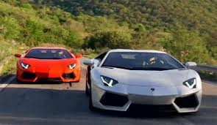
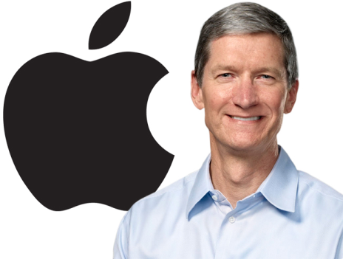

The Cleanup
How much is getting cleaned up?
  Sediment Volume: _______ cubic yards
    Divide that number by 15.4, that’s how many dump trucks you will need.
  ______ acres of aquatic habitat
How much does it cost?
  For every $1 million, you can:
    Buy two Lamborghini Aventadors
    Meet for coffee with Apple CEO, Tim Cook, twice
    Buy ONE bottle of “Gout de Diamants’ champagne.
Notes:
It’s important to clean up the polluted sediment out of ______________. When the waterway is all cleaned up, the project will have removed 4 [get number from www.greatlakesmud.org] cubic yards of sediment, ♦ Have students divide the number by 15. This is the number of dump trucks needed to remove the sediment.
Anyone want to guess how much the total cost is? (AUDIENCE)
♦ About $____________! So you can clean up the _____________, ♦ or buy _____ Lamborghinis, meet with Apple CEO, Tim Cook __________ times, or buy ____ bottles of this very expensive champagne!

Slide 17
How Do You Know What’s Polluted and Where It Is?
You’ve talked about how to tell if something is polluted.
Today we’ll do an experiment to help understand how scientists study pollution.
Notes:
Read the slide to prepare the students for the last activity of the day

Slide 18
How Does Pollution Affect the Ecosystem and the Habitat?
Another thing scientists think about is how the pollution affects an ecosystem.
Sometimes it affects different parts of the food chain in different ways.
If we cleaned up the polluted sediment for the plants – how much would we need to clean up? How about for the falcon?
Notes:
Read the slide to prepare the students for the last activity of the day

Slide 19
Experiment
We will break into teams.
Each team will get an ‘ecosystem’ to experiment with and will be given supplies.
Each team will use their supplies to make their experimental ecosystems polluted (for our experiment, we are using safe materials for our pollution).
Then the teams will trade ecosystems. The teams will have to try and determine what the other team’s ecosystem is polluted with.
Notes:
Read the instructions to the students and lead them through the pollution activity.

