Slide 1
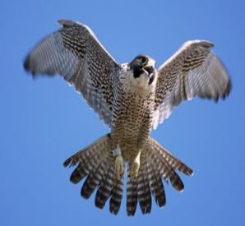
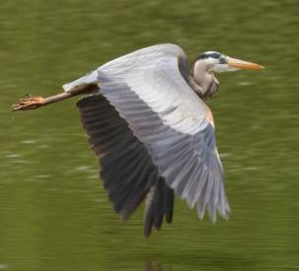
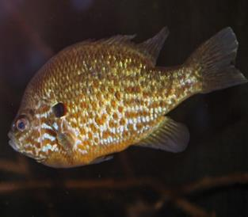
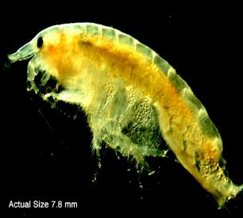
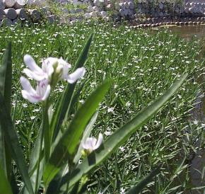
HABITAT
Notes:
Note to teachers: Please make sure that you use food chain species that represent your Area of Concern waterbody. Feel free to replace pictures and slides with those species.

Slide 2
Vocabulary
Habitat
River
Wetland
Sediment
Pollution
Organism
Organism
Population
Community
Ecosystem
Native
Invasive
Notes:
These are the terms we will be sharing with you today.
Does anyone know what any of these mean?

Slide 3
Habitat
What is a habitat?
The place where a plant or animal normally lives
What do you need to live?
Food
Water
Shelter
What makes a habitat healthy?
Notes:
What do you think makes a habitat healthy? Unhealthy?

Slide 4
Examples of habitat
Aquatic - water
Terrestrial - land
Lake
River
Pond
Wetland
Forest
Prairie
Desert
City
Notes:
Here are some examples of aquatic habitats and terrestrial habitats. What kinds of animals might you find in an aquatic habitat? In a terrestrial habitat?

Slide 5
What is your habitat?
Notes:
What are the parts of your habitat? (Remind them that a habitat is composed of food, water, and shelter. Have them compare their house to a river habitat.)

Slide 6
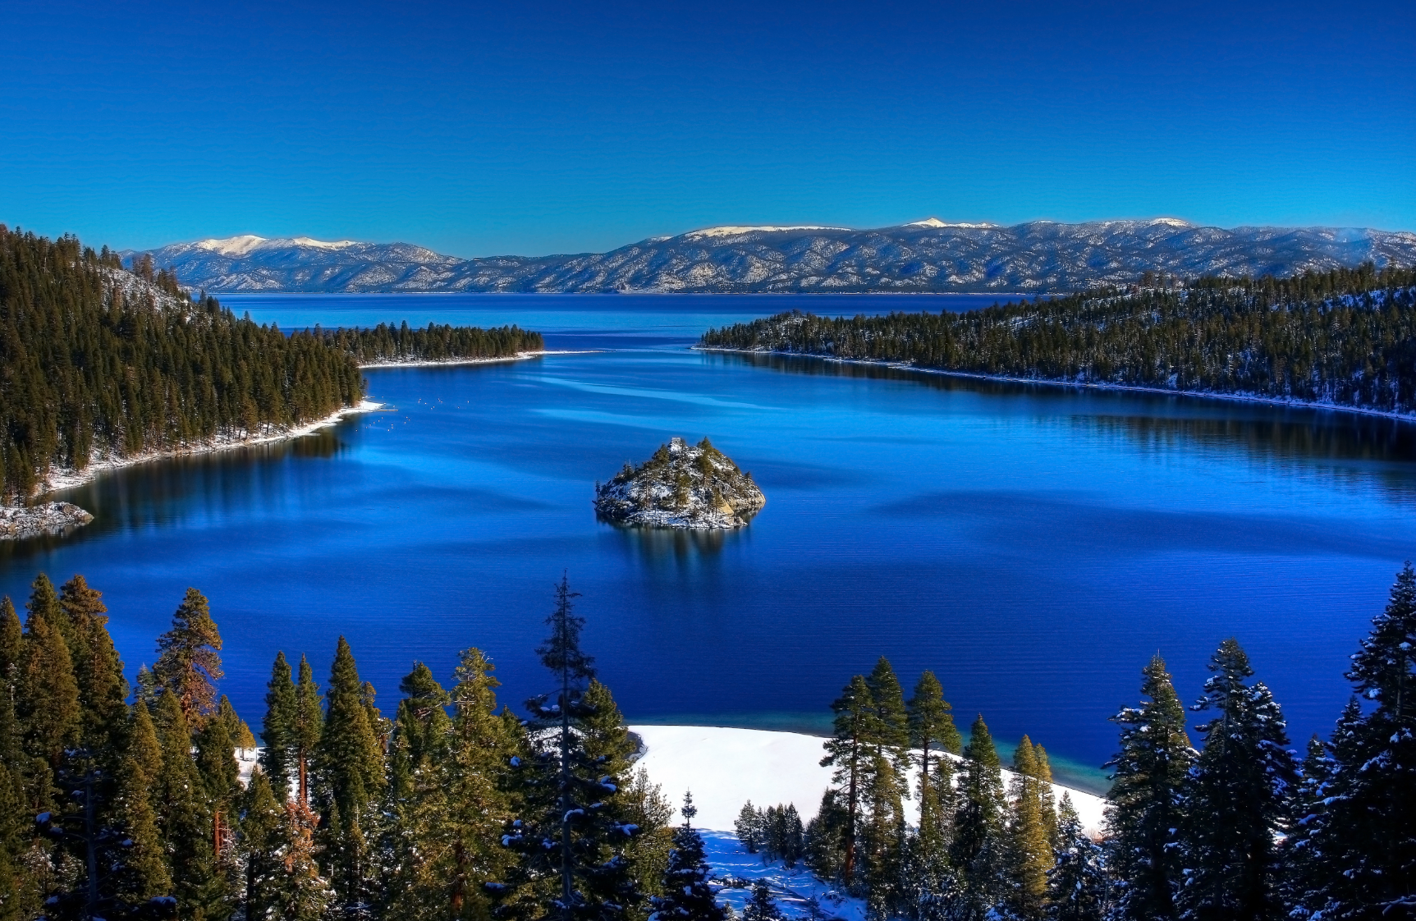
lake

Slide 7
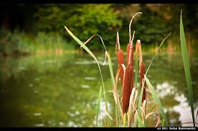
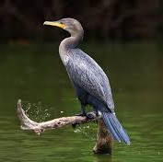
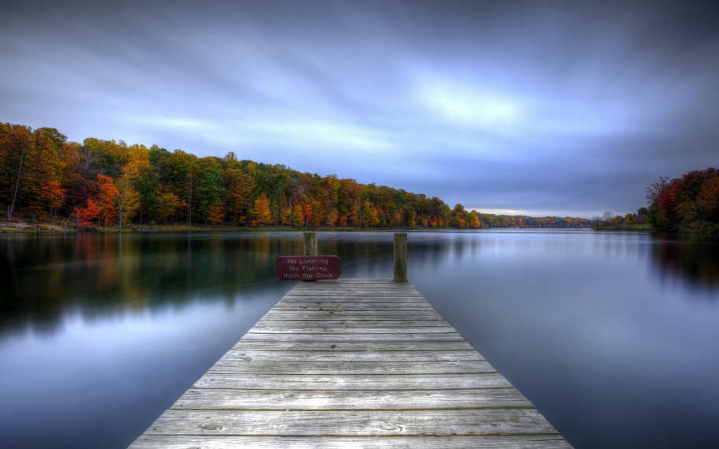
What is a lake?
A large body (> 2 acres) of water surrounded by land
Provides habitat (food, water, and shelter) to many organisms.
Source of recreation

Slide 8
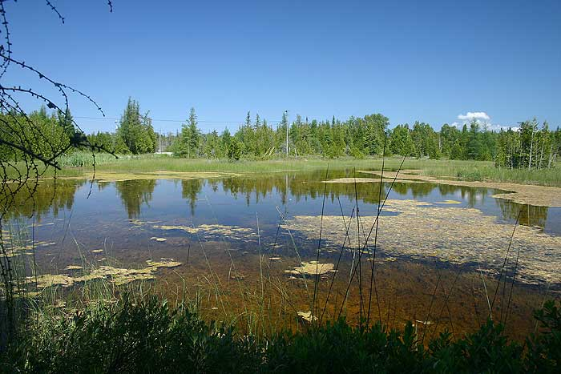
pond

Slide 9
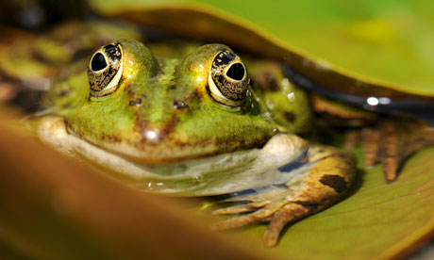
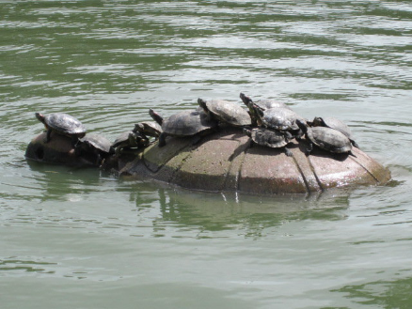
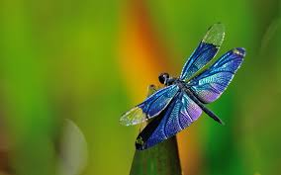
What is a pond?
A still body of shallow water generally smaller than 2 acres
May be formed naturally or manmade and filled by an underwater spring or rainwater
Home to fewer and smaller organisms

Slide 10
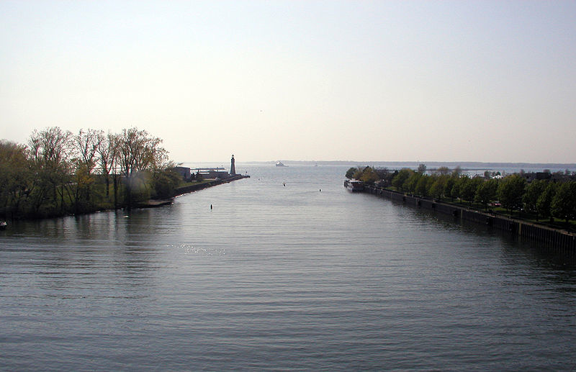
river
Notes:
A river is an example of a habitat. A lot of animals and plants live in the river and depend on it for food, water, and shelter.

Slide 11
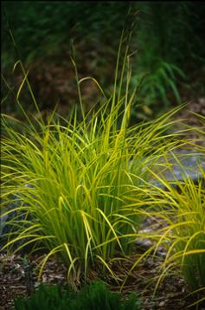
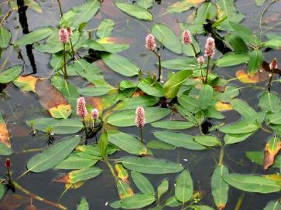
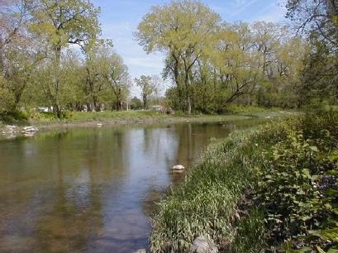
What is a river?
Waterway that flows toward another body of water
Provides habitat for a variety of organisms
Rivers provide many uses, such as food, transportation, energy, and recreation
Notes:
A river is a waterway that flows toward another body of water. It provides habitat for a variety of organisms. Rivers provide many uses, such as food, transit, energy, and recreation.

Slide 12
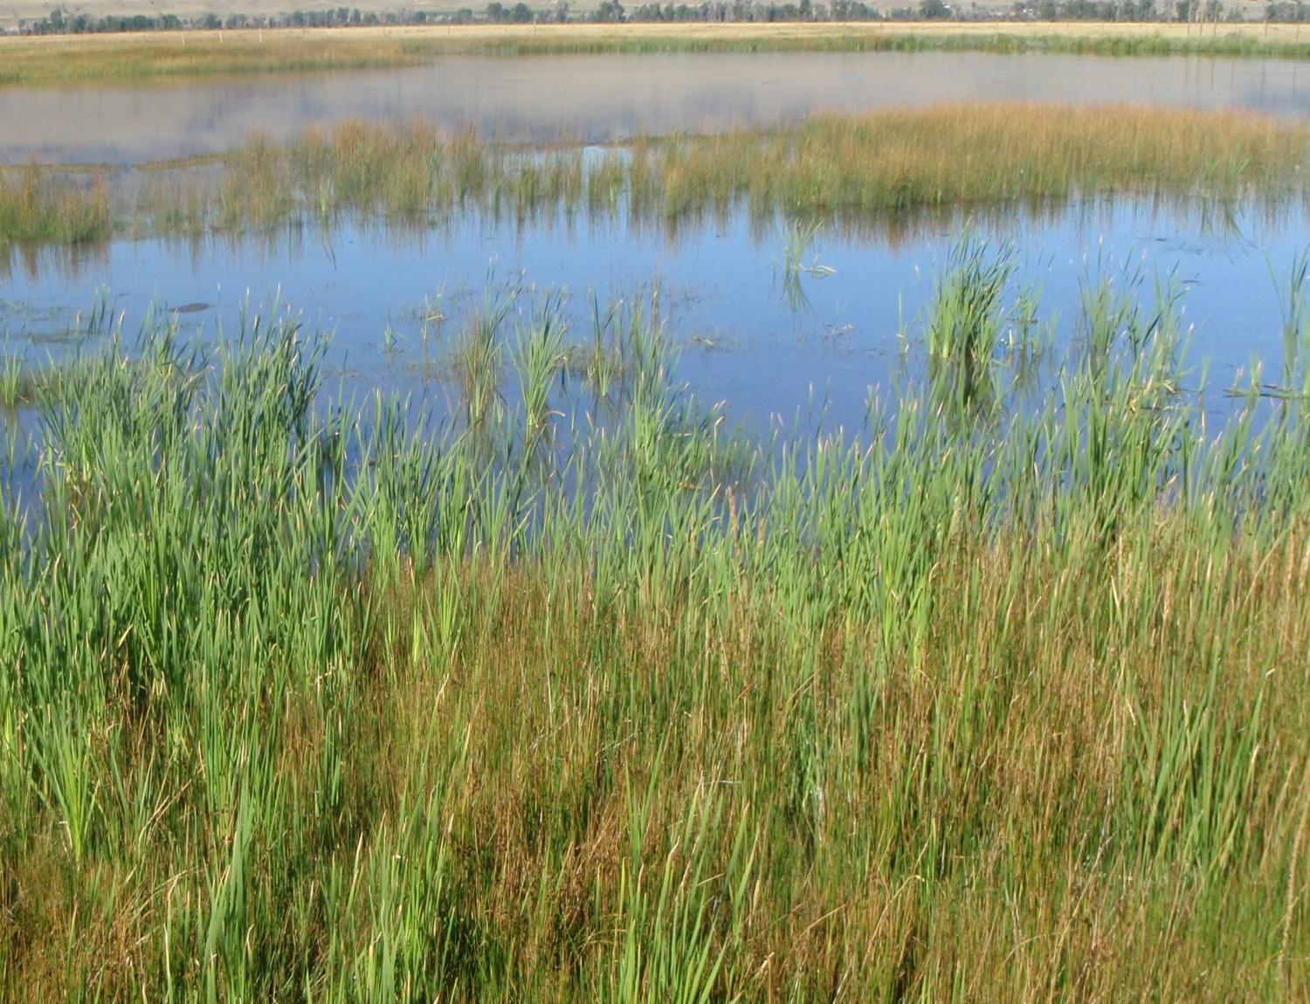
wetland
Notes:
A wetland is another type of habitat.

Slide 13
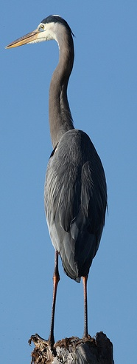
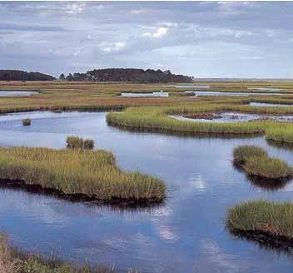
What is a wetland?
low land + water + lots of plants and animals
= wetland!
Key Ingredients:
Shallow water or very soggy soil at least part of the time.
The plants love having wet "feet" (roots).
Notes:
Think of it as a low, flat stretch of land that is covered with water
It’s often located between dry land and large bodies of water.

Slide 14
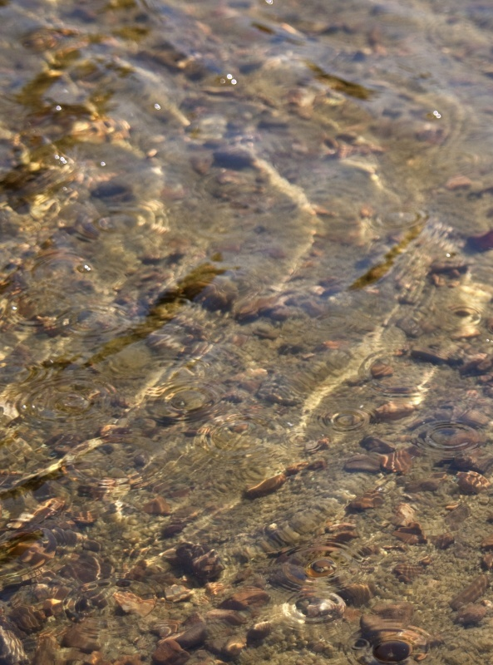
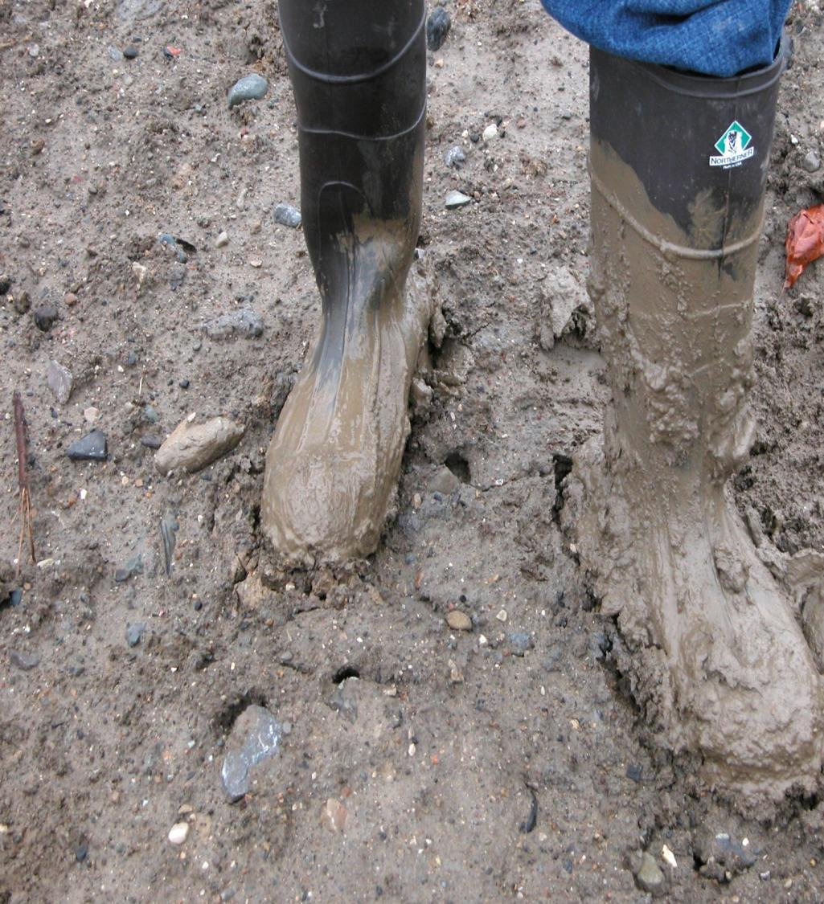
sediment
Notes:
Sediment is just one part of the habitat. It’s very important to the Great Lakes

Slide 15
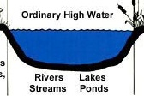
What is sediment?
The loose sand, clay, silt and other stuff that settle at the bottom of a body of water.
It’s similar to soil. Made up of living and non-living things.
It’s the foundation of the habitat.
Notes:
Who knows what soil is?
Sediment is like soil, only it’s under water. It’s the squishy stuff between your toes. It’s the foundation, or base, of the habitat. If you don’t have sediment, you don’t have plants growing in the sediment, and you don’t have fish swimming around the plants.

Slide 16
What does sediment tell us?
Not just current pollution but pollution from the past
Pollution that flows down a river settles into the sediment
We study sediment pollution to decide how to clean up a river or lake
Home for aquatic animals and fish
Notes:
We study the sediment so we know if we should clean it up.
it tells us exactly what we need to do to clean it up.
We want to clean it so it can provide a great habitat for the animals and fish.

Slide 17
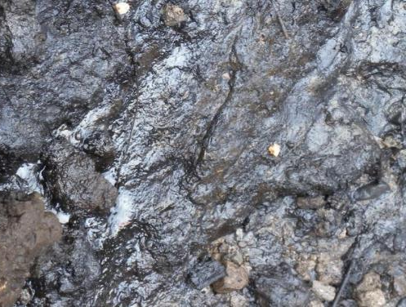
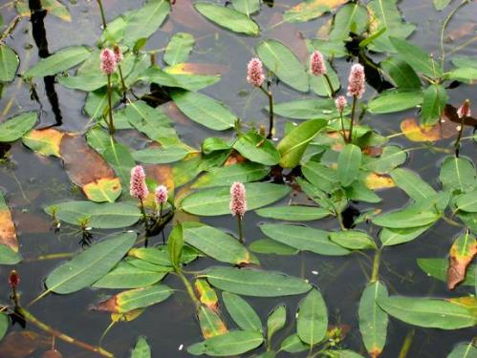
Aquatic ecosystems are habitats for many species
Why are we working here?
Contaminated sediment (polluted mud)
Degraded habitat
What are we doing?
Removing the pollution
Removing invasive plants
Adding native plants
Pollution
Water smartweed
Notes:
Because the Area of Concern is a habitat for so many species, we need it to be clean. There are projects in the Area of Concern to take out contaminated sediment so that the river will be a cleaner home for many organisms. There are also projects to remove invasive plants, and add native plants. Who knows what invasive means? Who knows what native means? Why are invasive plants and animals bad? Why do we want native plants and animals in the Area of Concern? (They provide habitat for other native organisms.)

Slide 18
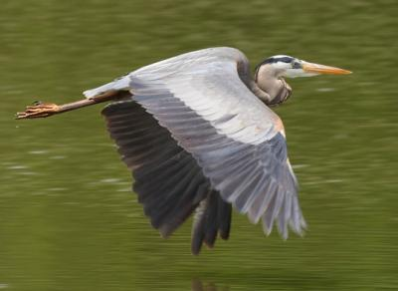
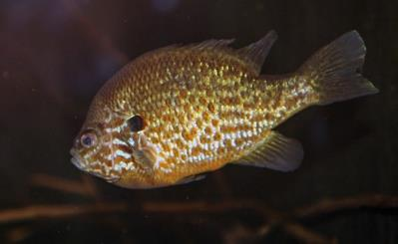
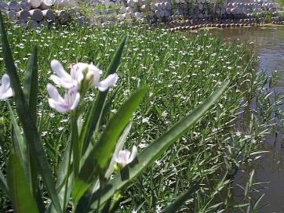
Important Ecological Terms
Peregrine Falcon
Organism: one individual of a species
Population: a group of organisms of one species living in the same place
Community: many populations of different kinds of organisms living in the same place
Ecosystem: communities and the non-living parts of their surroundings
Great Blue Heron
Pumpkinseed
Benthic Organism
American water-willow
Notes:
Important Ecological Terms
Organism: one individual of a species
Population: a group of organisms of one species in an area
Community: many populations of different kinds living in the same place
Ecosystem: assemblages of organisms together with their physical and chemical environments
Draw spacial, concentric circles on the board to illustrate this concept

Slide 19
The Great Blue Heron
What do we know about the great blue heron?
What does it eat?
What kind of habitat does it need?
Notes:
Prepare the students for the activity by getting them excited and interested in the great blue heron. The next slide answers the questions on this slide.

Slide 20
The Great Blue Heron
Food
Frogs
Fish
Wetland insects
Insects
Meadow voles
Shelter
Tall trees, reeds, and grasses
Dead branches and twigs to make platform nests
Water
Lakes and ponds
Marshes
Streams and rivers
Space
Lakes and ponds
Marshes
Streams and rivers
Logs and woody debris in the water
Forests with tall trees near the water
Notes:
Use this information to answer the questions on the previous slide.

