Slide 1
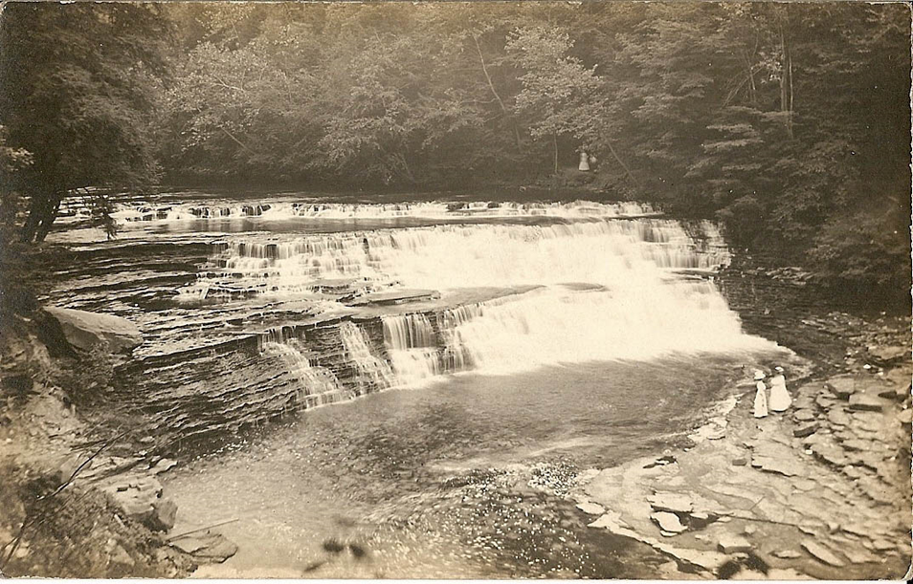
Gorge Dam Removal: Cultural Resources
“…every natural spot in the county preserved as a park, its wooded places made beautiful and its waters conserved.” (William J. Laub, 1921)

Slide 2
Purpose of Presentation
Section 106 of the National Historic Preservation Act of 1966 (NHPA):
Requires federal agencies to take into account effects of an undertaking on historic properties
Must allow time for comment, consultation
Public involvement is part of the process!

Slide 3
Purpose of Presentation
Section 106 of the National Historic Preservation Act of 1966 (NHPA):
Requires federal agencies to take into account effects of an undertaking on historic properties
Must allow time for comment, consultation
Public involvement is part of the process!

Slide 4
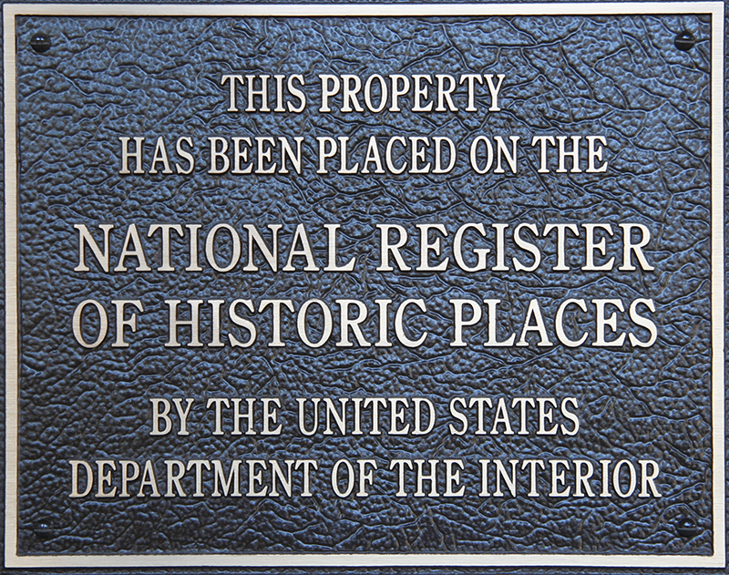
Purpose of Presentation
Historic properties are any prehistoric or historic districts, sites, buildings, structures, or objects that are eligible for or already listed in the National Register of Historic Places.

Slide 5
Gorge Dam Removal
What kind of impacts?
Removal of the sediment
Storage of sediment
Removal of the dam
Exposure of the riverbank
Change in viewshed

Slide 6
Purpose of Presentation
If an undertaking will impact a historic property, then what?
Avoid impacts
Minimize impacts
Mitigate impacts
Mitigation: documentation, public programming, preserving part of the site for interpretation—just to name a few options!

Slide 7
Purpose of Presentation
Public comments about cultural resources:
During public involvement meeting (in person or on written forms)
Online (SITE)
Can send to contact information
Your comments and input are important!

Slide 8
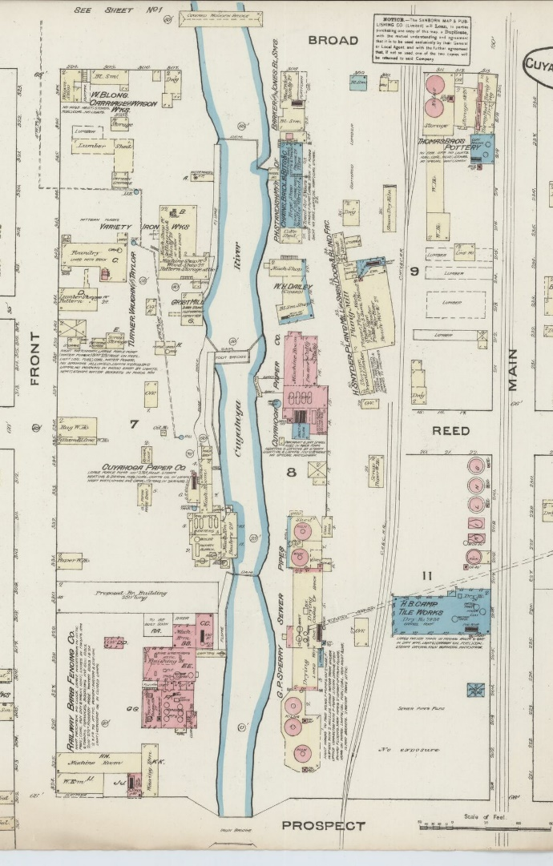
History of the Gorge
1700’s
Seasonal Native American residence, hunting and travel
Creation of Northwest Territory, continued westward European migration
1778
1803
Ohio Statehood
1836
Both Cuyahoga Falls and Akron incorporated
1840-44
Chuckery Race constructed
1884 Sanborn Fire Insurance Map. (Library of Congress)
5 dams provide water power to various industries along the river
1854

Slide 9
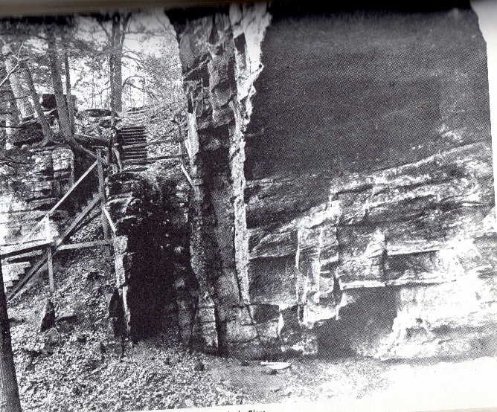
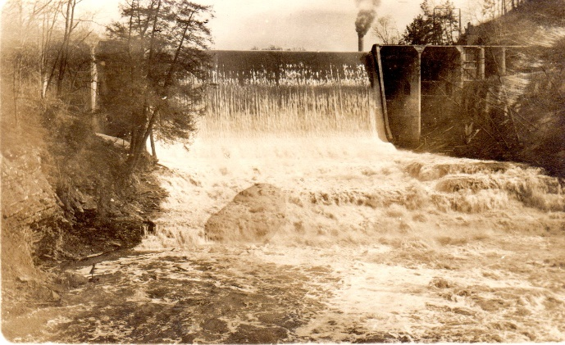
History of the Gorge
1876
High Bridge constructed at Prospect St.
1879
High Bridge Glens and Park opens
ca. 1895
Front Street bridge constructed; streetcar lines run to Gorge
1912
Current dam constructed by NOL&T
Stairs to Old Maid’s Kitchen. (Mary L. McClure)
ca. 1915
River View Amusement Park opens
1929
Akron Metro Parks assumes ownership of Gorge
Dam, 1914. (Mary L. McClure)
1933
Roseland Dance Hall closes

Slide 10
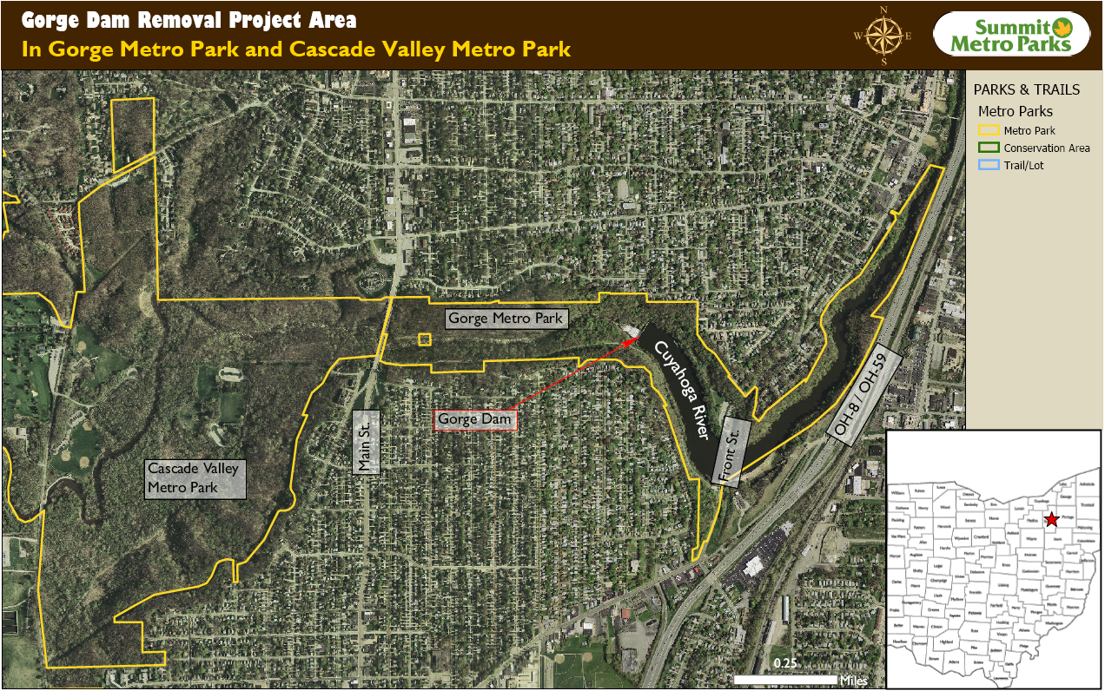
Gorge Dam Removal Project Area

Slide 11
Gorge Dam
Gorge Dam

Slide 12
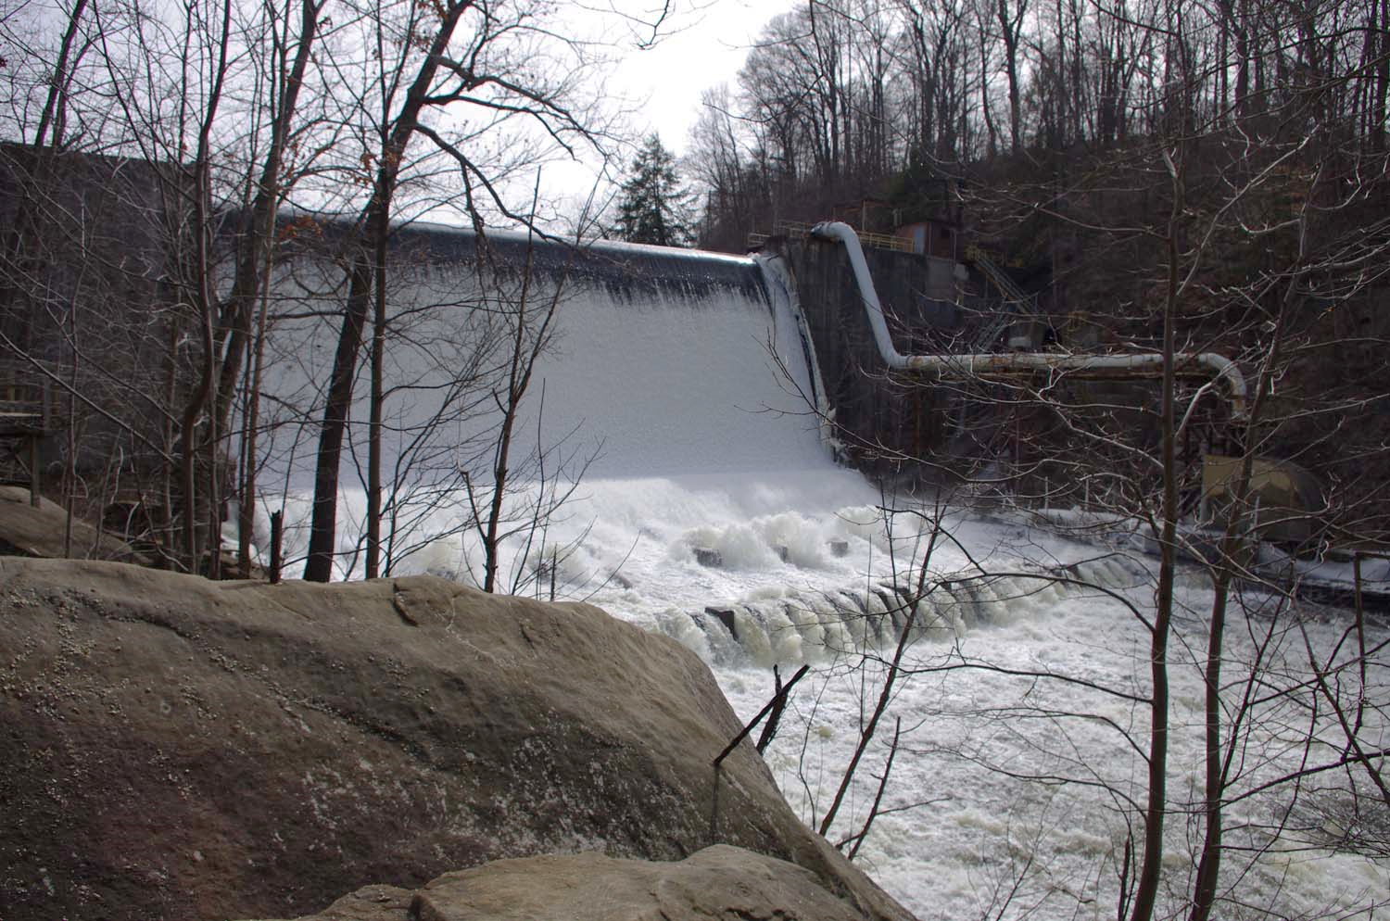
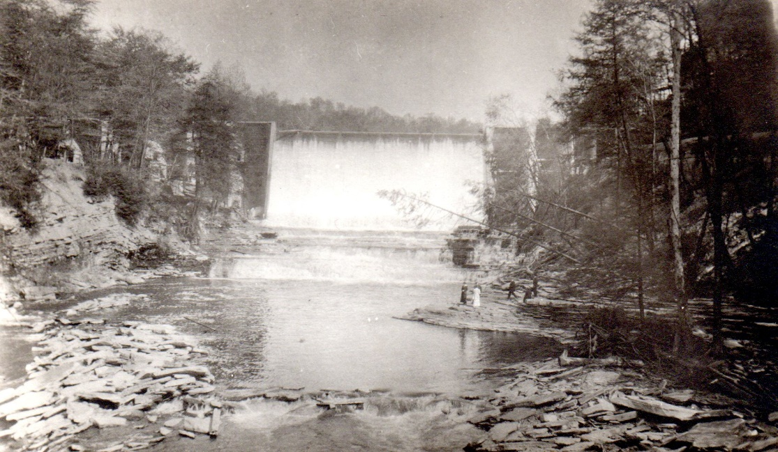
Gorge Dam
Gorge Dam: Constructed 1911-1912 by the Northern Ohio Light & Traction Co. (First Energy). Power-related use ceased in 1991.
Impacts:
Physical removal of structure

Slide 13
Related Power Features and Structures
NOT&L hydro plant
penstock saddles
NOT&L power plant

Slide 14
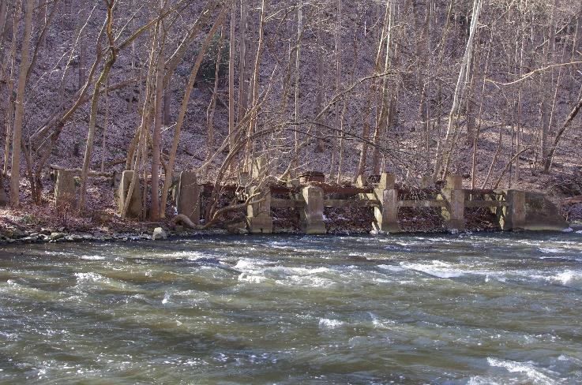
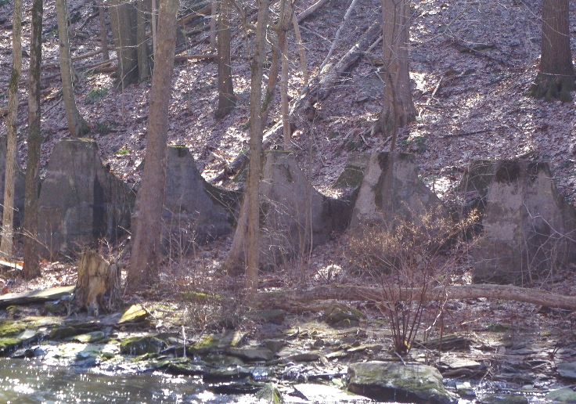
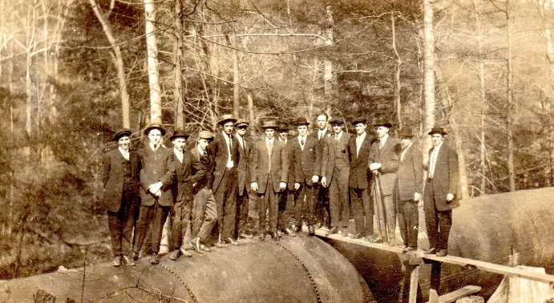
Related Power Features and Structures
Features related to Dam:
Hydro plant: Turbine generation plant downstream, 1915-1958. Currently in ruins.
Penstock: 8’ diameter pipe with concrete supports,1915. Pipe removed.
Power Plant: 1911 coal-fired plant demolished in 2009.

Slide 15
Related Power Features and Structures
Impacts:
Hydro plant:
no expected impacts
Penstock:
no expected impacts
Power plant:
exposure of retaining wall as water recedes
No expected impacts

Slide 16
Natural Features
Old Maid’s Kitchen/ Mary Campbell’s Cave
The Big Falls

Slide 17
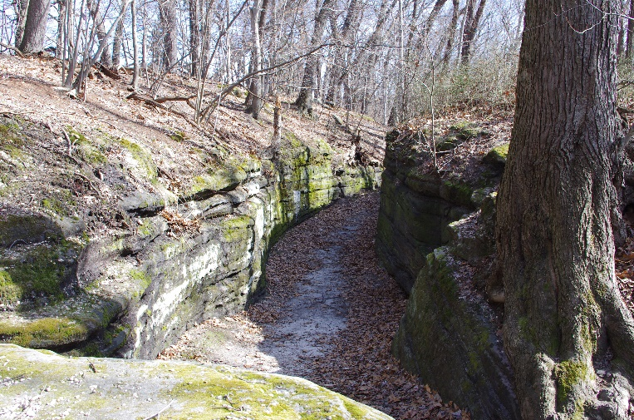
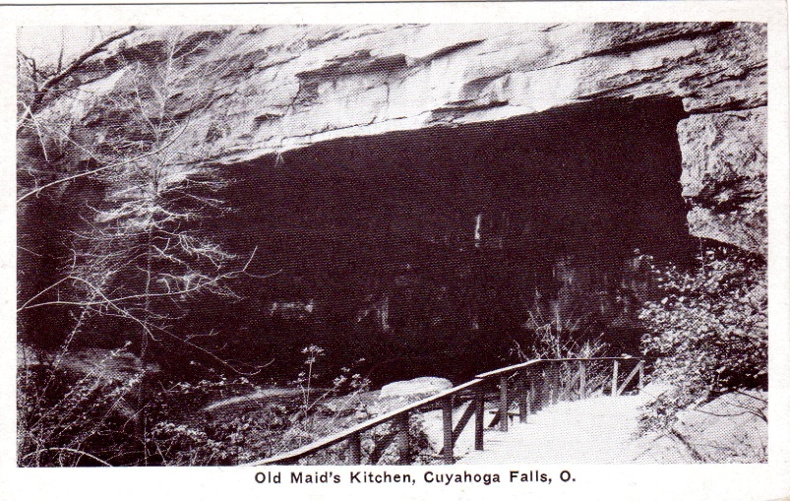
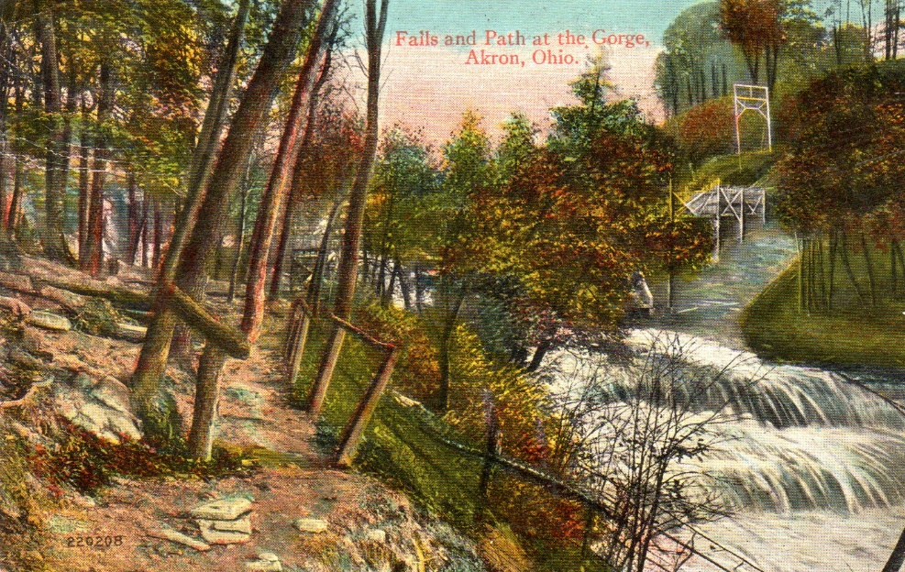
Natural Features
Natural Features
Big Falls: currently covered by dam
Caves/shelters, rock formations

Slide 18
Natural Features
Impacts:
Big Falls
Removal of dam may reveal Falls
Other natural features
Change in viewshed (closer to original?)

Slide 19
Bridge Remnants
Gorge footbridge
Akron, Bedford, and Cleveland Bridge

Slide 20
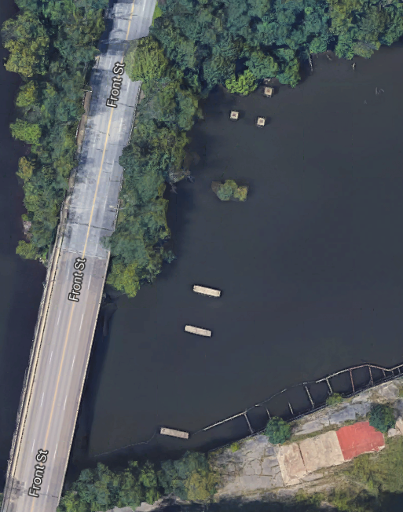
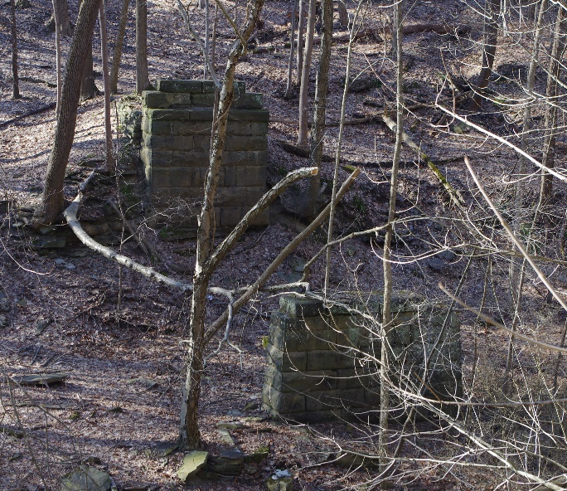
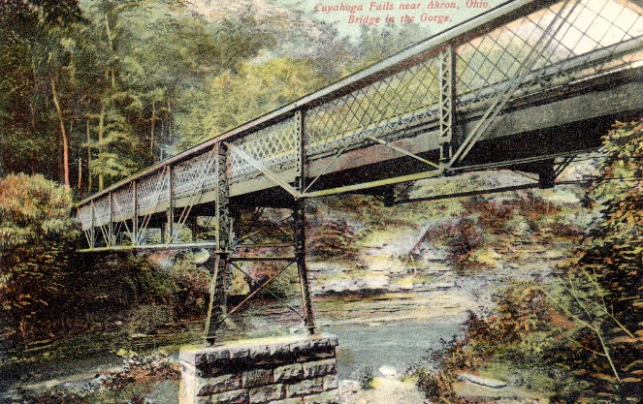
Bridge Remnants
Footbridge remnants: constructed ca. 1890 for amusement park. Only south abutments remain.
Akron, Bedford & Cleveland Bridge (streetcar). 1903. Demolished in 1980; piers/abutments remain submerged.

Slide 21
Bridge Remnants
Impacts:
Footbridge remnants
No impacts
The Akron, Bedford, and Cleveland Bridge
Existing piers exposed

Slide 22
The Chuckery Race

Slide 23
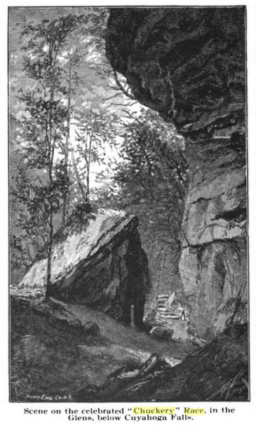
The Chuckery Race
Chuckery Race
Waterway built 1843-1844 intended to provide water power to industries
Parallels the Cuyahoga River for approximately 4 miles downstream from Prospect Street
Listed in National Register in 1973
Generally extant with varying levels of integrity along its length.
Photo from Fifty Years and Over of Akron and Summit County by Samuel A. Lane, 1892

Slide 24
The Chuckery Race
Impacts:
On National Register of Historic Places, so this is a known historic property
Removal of dam, exposure of riverbed, change in viewshed should not adversely impact this feature

Slide 25
Picnic Shelter, Skating Area
Gorge shelter
Skating area

Slide 26
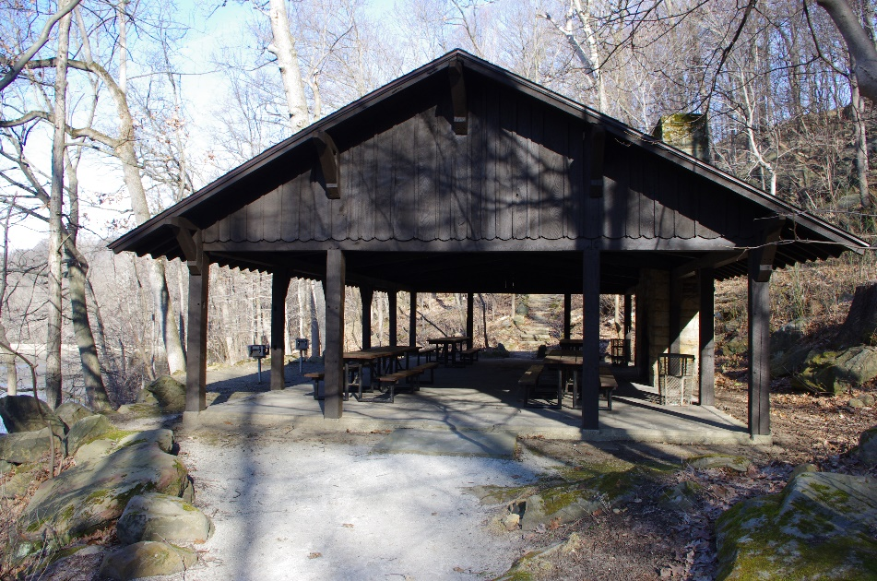
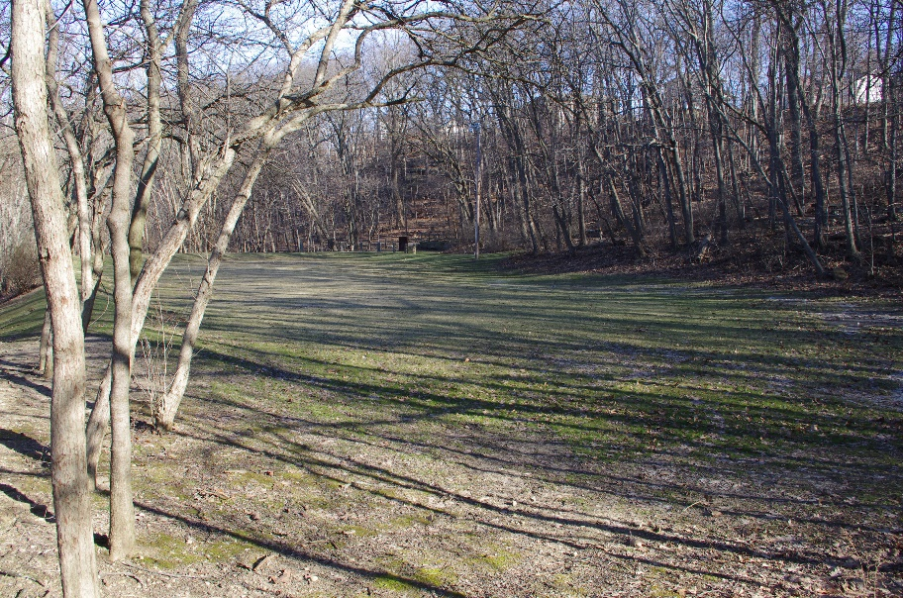
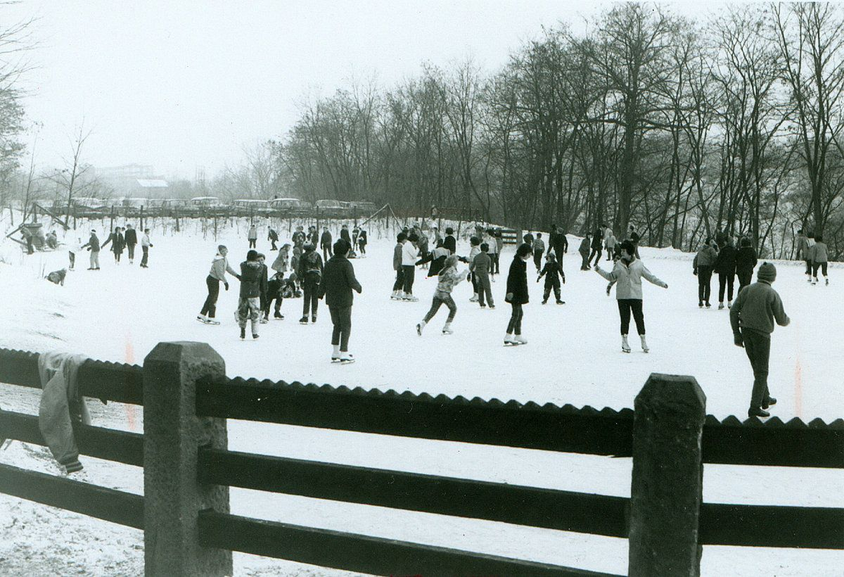
Picnic Shelter, Skating Area
Gorge Picnic Shelter, 1933. Constructed by CCC. Historically significant.
Ice Skating area, first used in 1947. Minor extant features.

Slide 27
Picnic Shelter, Skating Area
Impacts:
Gorge Picnic Shelter
Change in original viewshed
Skating area
Change in original viewshed

Slide 28
Sediment Placement

Slide 29
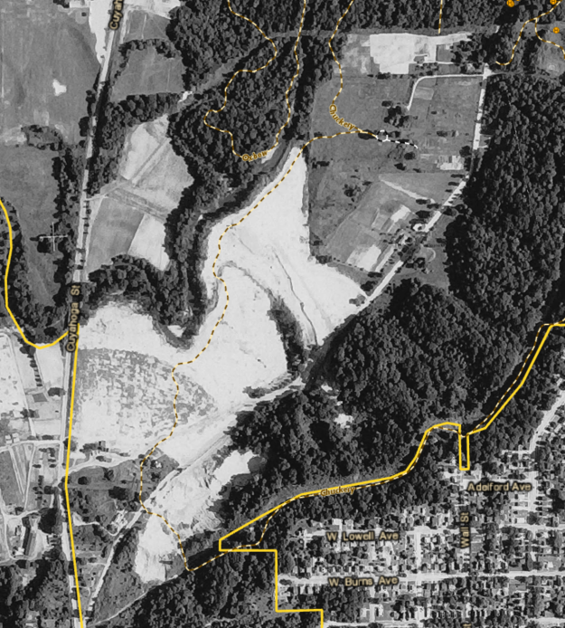
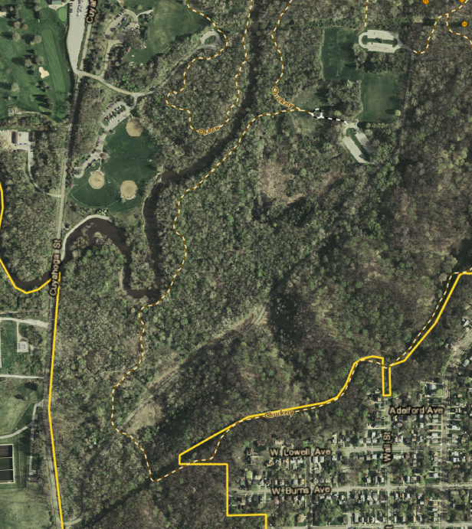
Sediment Placement
Disturbed by human dumping activity, earthmoving
No impacts to cultural resources
1959
2014

Slide 30
Underwater Resources?

Slide 31
Underwater Resources?
Are there cultural resources under the water?
Caves? Trails? Stairs, benches? Artifacts?
Monitor as water level goes down and river banks are exposed
Field checks
Drone?
Coordinate to identify, document, conserve, protect, interpret!

Slide 32
Planning for Cultural Resources
Assessment of resources
Formalized agreement noting impacts and recommendations for avoidance, minimization, or mitigation
Likely a programmatic agreement
Consulting parties such as American Indian tribes and local historical societies

Slide 33
Comments about Cultural Resources
In writing during public involvement meeting
In person at public involvement meeting
On the Great Lakes Mud website at: https://www.greatlakesmud.org/gorge-dam---cuyahoga-river-aoc.html
By email: mshaeffer@summitmetroparks.org
By mail: Megan Shaeffer, Cultural Resources Supervisor, 975 Treaty Line Rd., Akron, OH 44313

Slide 34
Thank you!
Conservation Department
Summit Metro Parks
975 Treaty Line Rd., Akron, OH 44313
Megan Shaeffer, Ph.D.
Cultural Resource Coordinator
330-865-8057 ext. 225
mshaeffer@summitmetroparks.org

